Slide 1









IMF's Regional Economic Outlook for MENA:
An Uneven Recovery amid High Uncertainty
Tuesday, May 28, 4:00 – 5:15 p.m. (Kuwait Time)
In English with Arabic Interpretation
Paulo Drummond
Director, CEF
Moez Souissi
Deputy Director, CEF
Borislava Mircheva
Sr. Economist, MCD
Salem Nechi
Economist, MCD

Slide 2
تقرير صندوق النقد الدولي حول آفاق الاقتصاد الإقليمي لمنطقة الشرق الأوسط وشمال إفريقيا: تفاوت مستويات الانتعاش وسط حالة من عدم اليقين الشديد
الثلاثاء 28 مايو/ أيار من الساعة 4:00 إلى 5:15 مساءً (بتوقيت الكويت)
باللغة الإنجليزية مصحوبةً بالترجمة الفورية إلى اللغة العربية
سالم نيشي
اقتصادي في إدارة الشرق الأوسط وآسيا الوسطى
بوريسلافا ميرشيفا
اقتصادي أول في إدارة الشرق الأوسط وآسيا الوسطى
معز سويسي
نائب مدير مركز صندوق النقد الدولي للاقتصاد والتمويل في الشرق الأوسط
باولو دروموند
مدير مركز صندوق النقد الدولي للاقتصاد والتمويل في الشرق الأوسط

Slide 3





IMF's Regional Economic Outlook for MENA:
An Uneven Recovery amid High Uncertainty
تقرير صندوق النقد الدولي حول آفاق الاقتصاد الإقليمي لمنطقة الشرق الأوسط وشمال إفريقيا: تفاوت مستويات الانتعاش وسط حالة من عدم اليقين الشديد
1
Choose English or Arabic.
اختر اللغة: العربية أو الإنجليزية.
١
If you are joining by laptop/computer, tap on the globe icon.
في حالة الانضمام باستخدام اللابتوب أو الحاسوب، أنقر على الأيقونة الوضحة أعلاه.
If you are joining by phone, (a) tap on the “…” icon then (b) tap “Language Interpretation.”
في حالة الانضمام باستخدام الهاتف، (أ) أنقر على أيقونة "..." ثم (ب) اختر “Language interpretation“ للاستماع إلى الترجمة الفورية.
2
We are recording this webinar.
سنقوم بتسجيل هذه الحلقة النقاشية.
٢
3
Make sure microphone and camera are turned off.
تأكد من إغلاق الميكروفون والكاميرا في جهازك.
٣
4
Rename your Zoom profile with full name, agency, country.
أعد تسمية واجهة المستخدم في تطبيق “Zoom" بحيث تتضمن اسمك بالكامل وجهة عملك وبلدك.
٤
This will help us record attendance and identify you for Q&A.
سيساعدنا ذلك في تسجيل الحضور والتعرف على المتحدث عند طرح الأسئلة.
5
Please submit your questions in Q&A.
يرجى كتابة الأسئلة باستخدام “Q&A“ الموضحة في الصورة.
٥

Slide 4
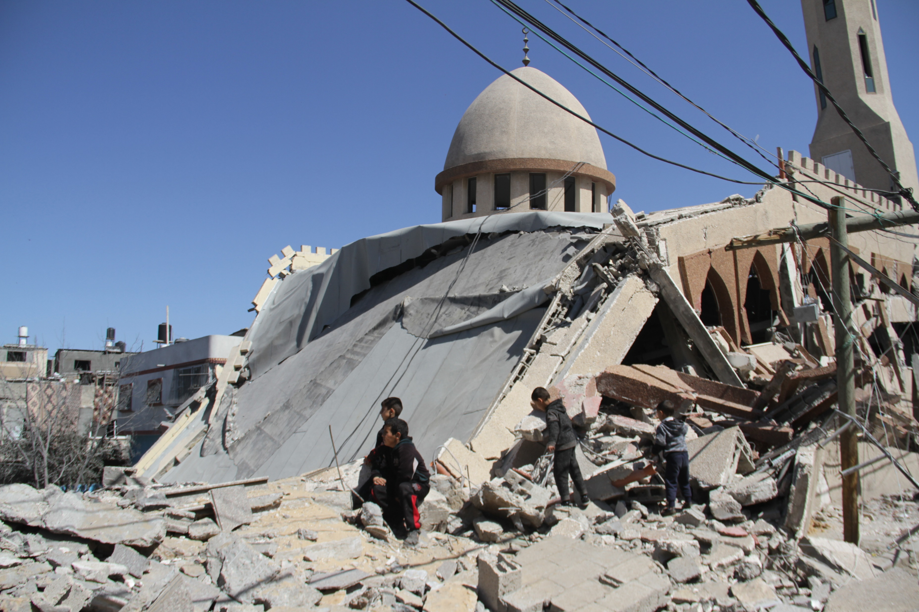
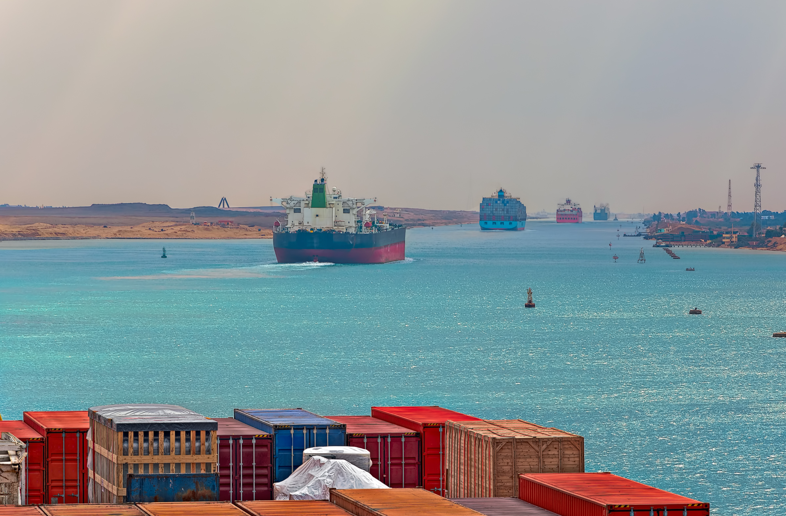

Middle East and Central Asia
Regional Economic Outlook
An Uneven Recovery amid High Uncertainty
May 2024
Notes:
Photo 1: Al-Shuhada Mosque, Gaza, Photo by Mahmoud Issa/Anadolu via Getty Images
Photo 2: Suez Canal – The HISTORY Channel, iStock.com/Tangyu Zhang
Photo 3: Ancient Arab spice market, Dubai, iStock.com/Tangyu Zhang

Slide 5
Recent Developments

Slide 6
Growth in MENA is slowing, amid declining inflation
Growth has slowed across the region…
…and inflation has declined, but remains high in some countries
MENA EM&MI and GCC: Real GDP Growth
(Year-over-year percent change)
MENA: Headline Inflation
(Year-over-year percent change, weighted average)
Sources: Haver Analytics; and IMF staff calculations.
Sources: Haver Analytics; national authorities; and IMF staff calculations.

Slide 7
Conflicts are impacting trade, transportation, and neighboring economies, while financial markets remain stable
Disruptions in the Red Sea impacted shipping and traffic through the Suez Canal…
…with notable impacts on trade volumes in surrounding ports
Sovereign spreads have mostly returned to pre-conflict levels
Impact on Shipping Costs and Volumes
(Index, October 1, 2023=100)
Trade Volumes, Seasonally Adjusted
(Percentage change, February 2024 as compared to November 2023, and February 2023)
JP Morgan EMBIG Spreads
(Basis points)
Spreads widened
Spreads narrowed
Source: Bloomberg Finance L.P., PortWatch; and IMF staff calculations.
Note: The Europe/Mediterranean to China route shipping cost is the average cost for shipments between ports in Europe or the Mediterranean and ports in China or East Asia.
Sources: PortWatch; and IMF staff calculations
Note: The data capture trade in goods.
Source: Bloomberg Finance L.P

Slide 8
Amid easing inflationary pressures, monetary policy tightening is likely coming to an end, while fiscal outturns are mixed
Monetary tightening is likely coming to an end…
…while fiscal outturns were mixed
MENA: Policy Interest Rates
(Percent)
MENA: Change in Primary Balances (excluding grants), 2022-23
(Percent of GDP; Percent of Non-oil GDP for Oil Exporters, average)
Sources: Haver Analytics; National authorities; and IMF staff calculations.
Note: Country abbreviations are International Organization for Standardization country codes. The ranges around the neutral rate estimates reflect one SD confidence intervals.
Sources: IMF, World Economic Outlook database; and IMF staff calculations.
Note: Country abbreviations are International Organization for Standardization country codes. EM&MI = emerging market and middle-income economies; GCC = Gulf Cooperation Council; LIC = low-income country; OE = oil exporter

Slide 9
Outlook

Slide 10
No break from challenges for MENA economies
MENA: Real GDP Growth, 2024-26
(Year-over-year percent change)
Sources: IMF, World Economic Outlook; and IMF staff calculations.

Slide 11
Oil dependence, conflicts, uncertainties and policy settings are shaping an uneven recovery across MENA economies
Growth in 2024 is weighed down by oil
production cuts and uncertainty
Inflation has peaked in most countries and is
expected to decline further, but differences persist
MENA: Revisions to GDP Growth and Contributions
(Percent change, year-over-year; percentage points for revisions)
MENA: Headline Inflation
(Percent change, year-over-year, weighted averages)
Sources: IMF, World Economic Outlook database; and IMF staff calculations.
Sources: IMF, World Economic Outlook database; and IMF staff calculations.

Slide 12
However, elevated debt levels and borrowing costs pose financing challenges among MENA EM&MIs
Debt levels are highest in EM&MIs …
… amid persistent financing needs…
…with high interest expenditures adding to debt pressures
Gross Public Debt, 2024
(Percent of GDP)
MENA EM&MI: Gross Financing Needs
(Percent of fiscal revenues; simple averages)
MENA EM&MI: Contributions to Changes in Gross Public Debt-to-GDP Ratios
(Percentage points)
Sources: IMF, World Economic Outlook; and IMF staff calculations. Excludes Sudan.
Sources: IMF, MCD Regional Economic Outlook; and IMF staff calculations.
Sources: IMF, World Economic Outlook; and IMF staff calculations.
Note: "Other" includes contributions from the exchange rate, grants, and other flows.

Slide 13
Risks

Slide 14

Downside risks and uncertainty have risen
DOWNSIDE RISKS
GLOBAL
Abrupt global slowdown, including in China
UPSIDE RISKS
Persistent inflation and financial stress
GLOBAL
Worsening of geoeconomic conditions
Stronger-than-projected global growth
ME&CA
Faster-than-anticipated decline in inflation
Recurrent climate shocks
ME&CA
Escalation or protraction of conflict in Gaza and Israel / Red Sea disruptions
Permanent resolution of conflict in Gaza and Israel
Failure to make sufficient progress on implementing structural reforms

Slide 15
Policy Priorities

Slide 16
Balancing Policy Priorities in Uncertain Times
Recovery, Resilience, and Stability
In conflict-affected countries, prudent crisis management and precautionary policies will be critical
If FX flexible and inflation persists, maintain tight and data dependent policy
If RX pegged, make decisions in accordance with monetary framework
Monetary Policy
Fiscal Policy
Structural Policies
Central bank independence is key
Strengthen governance, including of the central bank
Commodity exporters should preserve fiscal buffers to foster resilience
If inflation persists, policy should remain tight and follow a data-dependent approach
Improve social safety nets
MENA EM&MIs will need to strengthen their fiscal positions to reduce debt decisively
Tailored to country needs
MENA EM&MIs will need to strengthen their fiscal positions to reduce debt decisively
Upgrade regulatory environments and infrastructure to diversify products and markets
If inflation is close to or below target, easing could be considered if conditions allow
Strengthen fiscal risk management, including implementing or bolstering existing medium term fiscal frameworks
Invest in education, digitization, and decarbonization
Avoid monetary financing so monetary policy can be a more effective tool to stabilize inflation
For LICs and FCS, improving food security remains a priority
16

Slide 17
The IMF remains strongly engaged in supporting the region
$32.8 billion of new financing for 8 MENA countries, since the pandemic, including recent Fund arrangements for Egypt, Mauritania, Morocco and Pakistan ($1.6 billion in RSF financing to Mauritania and Morocco).
The IMF has increased its outreach in the region:
  October 2023 Annual Meetings held in Marrakech;
  COP28 in the UAE and upcoming COP29 in Azerbaijan
  Riyadh conference on Industrial Policies (April 24-25);
  REO panel discussion at WEF (April 28).
  Recent regional surveillance and policy work
  January 2024 REO, with a focus on the conflict;
  Departmental papers: Regional integration in Africa, Climate finance, CBDCs in ME&CA
MENA: IMF Financing Since the Pandemic
(March 2020–March 2024, billions of US dollars)

Slide 18
CD continues to expand
CD Spending by Country Groupings
Concentrated in Programs and Fragile & Conflict-Affected States
ME&CA: Capacity Development Spending
by Country Groupings
Source: IMF staff calculations.
Note: LICs include Afghanistan, Djibouti, Kyrgyz Republic, Mauritania, Somalia, Sudan, Tajikistan, Uzbekistan, and Yemen.
Fragile and program countries include Afghanistan, Armenia, Egypt, Georgia, Iraq, Jordan, Lebanon, Libya, Mauritania, Morocco, Pakistan, Somalia, Sudan, Syria, West Bank and Gaza, and Yemen.
Data are as of March 8, 2024.

Slide 19
Thank you

Slide 20
Fragile Foundations: The Lasting Economic Scars of Conflict
Chapter 2 of April 2024 Regional Economic Outlook for the Middle East and Central Asia
Spring, 2024
Diala Al Masri, Vizhdan Boranova, Steven Dang, Colombe Ladreit, Troy Matheson (co-lead), Borislava Mircheva (co-lead), Thomas Piontek, and Bozena Radzewicz-Bak.

Slide 21
Motivation and Outline
  Conflict is a recurring challenge in the Middle East and Central Asia (ME&CA). It causes immense human suffering, as evidenced by the current conflict in Gaza and Israel.
  This chapter examines the economic consequences of conflict in ME&CA by assessing the impact on economic activity per capita and other key macroeconomic indicators, the spillovers to other economies, and its effects on key socioeconomic variables with longer-term implications:
        Regional conflict prevalence and intensity
        Social effects
        Economic effects
        Spillover channels

Slide 22
A Region Prone to Conflict

Slide 23
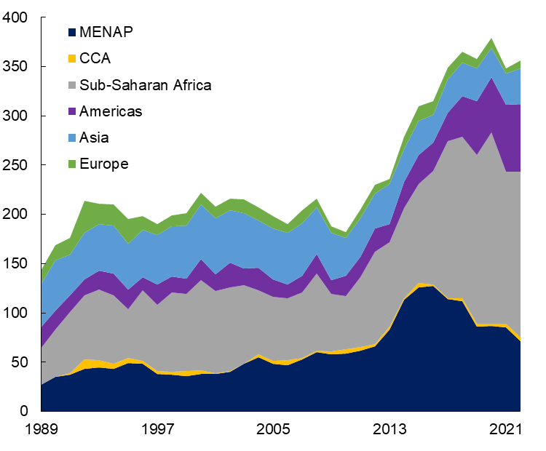
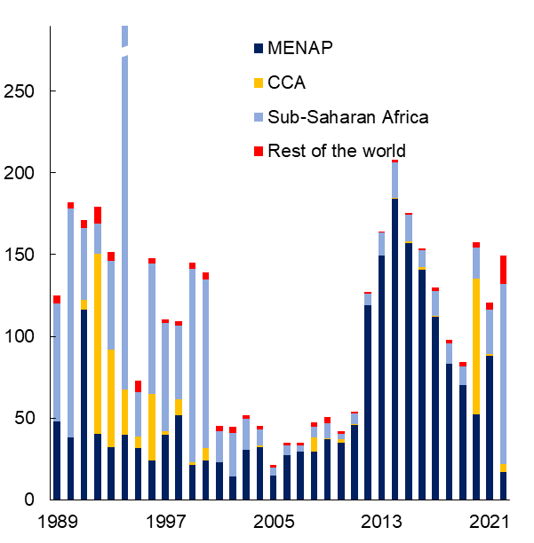
ME&CA has seen frequent and severe conflicts
Countries in ME&CA have experienced numerous within- and between-country
conflicts over recent decades
Levels of conflict-related deaths per capita have exceeded those in many other regions
Number of Conflicts by Region
(Number, 1989-2022)
Conflict-Related Deaths
(Per million people, 1989-2022)
Sources: Uppsala Georeferenced Event Database (v23.1.); IMF, World Economic Outlook; and IMF staff calculations.
Notes: For the middle chart, in 1994 the conflict in Rwanda drives the significant jump in the Sub-Saharan Africa data to over 1,000. In the right chart, acute and prolonged conflict is defined as a conflict episode preceded by two or three years of relative peace (zero or less than 25 deaths in aggregate), episodes with greater than 25 deaths per year (acute) per country after onset, and three or more consecutive years (prolonged) of active conflict. For the preconflict World Economic Outlook forecast, the fall vintage preceding the year of the onset of identified conflict episodes was used. This filters down to 12 key conflicts in the region. CCA=Central Asia and Caucus; ME&CA=Middle East and Central Asia; and MENAP=Middle East and North Africa, Afghanistan, and Pakistan.

Slide 24
Social Effects

Slide 25
Intense and prolonged conflicts can disrupt the accumulation of human capital and social cohesion
Rising sharply after the 2011 Arab Uprisings, ME&CA's displaced population makes up over 40% of the globally displaced
School enrollment rates decline, more so in cases of high intensity and prolonged conflicts
Forcibly Displaced People, 1975−2022
(Millions)
ME&CA Region: Primary School Enrollment in Prolonged versus Shorter Duration and High versus Low Intensity Conflicts (Percentage points)
Sources: United Nations High Commissioner for Refugees, World Economic Outlook; and IMF staff calculations.
Note: CCA=Central Asia and Caucus; ME&CA=Middle East and Central Asia; MENA=Middle East and North Africa

Slide 26
Economic Effects

Slide 27
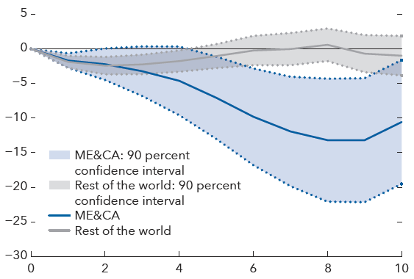
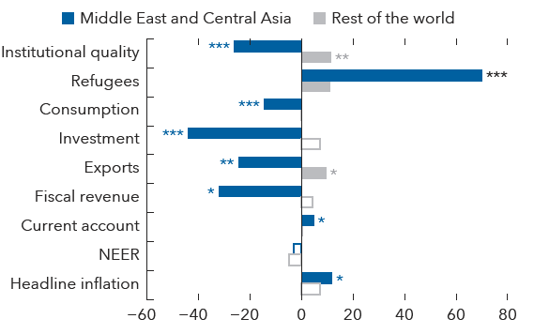
The impact of conflict in ME&CA economies…
… hits harder and lasts longer …
… with significant economic disruptions
Impact of Conflict on Real GDP per Capita (Percent)
Economic disruptions – Additional variables
(Percent difference between year 7 and the year before the conflict onset)
Sources: IMF, World Economic Outlook database; Uppsala Georeferenced Event Database (v23.1); and IMF staff calculations.
Note: The shock occurs in year 1 and corresponds to an increase in conflict intensity to the 75th percentile of the world distribution.
ME&CA = Middle East and Central Asia.
Sources: International Country Risk Guide; IMF, World Economic Outlook database; UN Refugee Agency, Global Trends Report 2022, Uppsala Georeferenced Event Database (v23.1); and IMF staff calculations.
Note: The figure shows the impact seven years after the shock, which corresponds to an increase in conflict intensity to the 75th percentile of the world distribution. ***, **, and * indicate statistical significance at the 1, 5, and 10 percent level, respectively. Empty bars indicate a lack of significance at the 10 percent level. Local projection results are available in Online Annex 2.2. All results are percent differences except for the current account balance as percentage of GDP, for which it is the percentage point difference. NEER = nominal effective exchange rate.

Slide 28
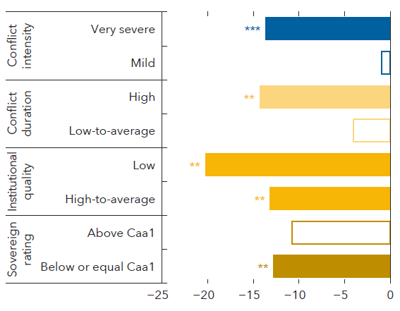
Heterogeneous effects are at play
Conflict characteristics and pre-existing economic conditions matter
Differential Impact on Real GDP per Capita According to Conflict Characteristics and Preexisting Economic Conditions
(Percent difference between year 7 and the year before the conflict onset)
Sources: Bloomberg Finance L.P.; International Country Risk Guide; IMF World Economic Outlook database; Uppsala Georeferenced Event Database (v23.1); and IMF staff calculations.
Note: The figure shows the impact seven years after the shock and corresponds to an increase in conflict intensity to the 75th percentile of the world distribution, except for the conflict intensity case which uses a categorical variable (see Online Annex 2.5). ***, **, and * indicate statistical significance at the 1, 5, and 10 percent level, respectively. Empty bars indicate a lack of significance at the 10 percent level. Local projection results are available in Online Annex 2.5. We use sovereign ratings from Moody’s and choose the threshold of Caa1 to ensure a big enough sample size.

Slide 29
Spillovers

Slide 30
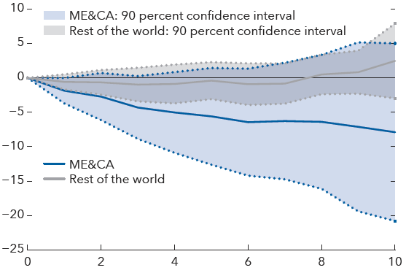
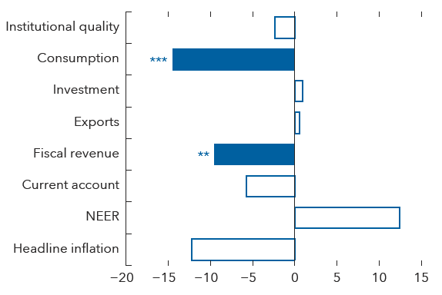
Spillovers from conflict are damaging to bordering economies
Bordering Economies’ GDP per capita is impacted negatively in response to an increase in conflict
And has long-lasting impacts on other macroeconomic indicators
Impact of Conflict on Bordering Economies’ GDP per Capita
(Percent)
Impact of Conflict on Bordering Economies’ Macroeconomic Indicators
(Percent difference between year 7 and the year before the conflict onset)
Sources: CEPII database; IMF, World Economic Outlook database; Uppsala Georeferenced Event Database (v23.1); and IMF staff calculations.
Note: The impact estimates approximately correspond to the deaths per million associated with the 75th percentile of the world distribution for the own country analysis (see Online Annex 2.3.1 for details on the mapping). ME&CA = Middle East and Central Asia.
Sources: CEPII database; International Country Risk Guide; IMF, World Economic Outlook database; Uppsala Georeferenced Event Database (v23.1); and IMF staff calculations.
Note: The figure shows the impact seven years after the shock which approximately corresponds to the deaths per million associated with the 75th of the world distribution for the own country analysis. ***, **, and * indicate the statistical significance at the 1, 5, and 10 percent level, respectively. Empty bars indicate a lack of significance at the 10 percent level. The impact on the current account balance is in percentage point change. NEER = nominal effective exchange rate.

Slide 31
Main Takeaways
ME&CA is one of the most conflict-prone parts of the world. The duration and intensity of conflict tend to be relatively high and have damaging long-term economic and societal impacts.
Conflicts in ME&CA have had, on average, more adverse and prolonged spillover effects for neighboring economies compared to elsewhere.
Amid heightened uncertainty related to conflict, these findings highlight the importance of crisis preparedness, strong institutions, and sound macroeconomic policies.

Slide 32
Annex

Slide 33
Local projection specification
We use the Jordà (2005) method of local projections and estimate dynamic responses by linear regressions of the following form:
$y_{i,t+h}−y_{i,t−1}=β_{1}^{h}C_{i,t}+ β_{2}^{h}C_{i,t}∗{MECAdummy}_{i}+\sum_{j=1}^{l}{β_{3,j}^{h}C_{i,t−j}}+\sum_{j=1}^{l}{γ_{1,j}^{h}\left(y_{i,t−j}−y_{i,t−j−1}\right)+\sum_{j=1}^{l}{θ_{j}^{h} X_{i, t−j}}+α_{i}^{h}}+α_{t}^{h}$+ $ε_{i,t}^{h}$
Where:
$y_{i,t}$ is log of per-capita GDP
$C_{i,t}$ is the conflict variable
$X_{i, t}^{j}$is a set of control variables which include trade openness (log), terms of trade (pct change), export partners growth, investment/GDP
$α_{i}^{h}$ and $α_{t}^{h}$ are country and time fixed effects, respectively
Two lags of GDP growth and the conflict variable are included
Standard errors are clustered at the country level
-$β_{1}^{h}$ directly estimates the impulse response of per-capita GDP for horizon h in response to a shock to the conflict variable among all economies excluding ME&CA countries.
- $β_{2}^{h}$ estimates the differential impulse response of per-capita GDP for horizon h in response to a shock to the conflict variable among ME&CA countries.
- Our average impulse response for ME&CA countries is the sum of $β_{1}^{h}$ and $β_{2}^{h}$.

Slide 34
Trade Patterns amid Shocks and a Changing Geoeconomic Landscape
April 2024
Regional Economic outlook: middle east and central asia
chapter 3
Notes:
Countries across MENA and the CCA have experienced numerous shocks in recent years, significantly reshaping their trade patterns. Following trade dislocation from the COVID-19 pandemic, Russia’s war in Ukraine contributed to changes in regional trade dynamics, especially for CCA countries. More recently, security tensions in the Red Sea have raised broader concerns about their impact on shipping costs and trade. This has increased the risk of trade and supply chain disruptions, not only in the MENA region but globally.
This presentation will focus on (1) the trade impact for recent shocks in MENA and CCA and (2) on the trade implications of a changing geoeconomic fragmentation landscape. In the last

Slide 35
Outline
Shocks and rising trade restrictions are reshaping trade
A changing geoeconomic landscape could further shift trade patterns
Decisive and targeted policy actions are needed

Slide 36
Shocks and rising trade restrictions are reshaping trade

Slide 37
Trade diversion following Russia’s war in Ukraine is reshaping trade patterns across the CCA and MENA regions
Rising trade shares with key trading partners, particularly in the CCA …
... amid higher exports across a wide range of products …
… and deepening involvement in Global Value Chains
Trade Shares with Partner Countries, 2021-22
(Percentage change)
CCA: Exports by Product Group
(Value change in billions of U.S. dollars, 2022 versus 2019-21 average)
CCA: Deepened Involvement in GVCs
(Change in index values, 2021-22)
Higher participation
More upstream
Sources: EORA MRIO database; and IMF staff calculations
Note: Both indices are calculated following Aslam, Novta, and Bastos (2017), based on manufacturing trade excluding extractive sector. Increasing participation implies greater integration with global value chains. Increasing position implies more upstream exports. Country abbreviations are International Organization for Standardization (ISO) country codes. CCA = Caucasus and Central Asia. & PAK = Middle East and North Africa and Pakistan.
Sources: CEPII BACI database; and IMF staff calculations.
Note: Percent change in the share of CCA, MENA and Pakistan, and Russia in exports and imports from/to selected trading partners between 2021 and 2022. CCA = Caucasus and Central Asia; MENA & PAK = Middle East and North Africa and Pakistan.
Sources: United Nations Comtrade; and IMF staff calculations.
Note: Excludes Tajikistan given data limitations. Country abbreviations are International Organization for Standardization (ISO) country codes.
Notes:
Figure 1: One of the implications of the war in Ukraine has been a shift in the direction of trade flows, including to and from the CCA. In 2022, the CCA’s share in EU, US, and Russian nonhydrocarbon exports increased by 25, 53, and 22 percent, respectively. In addition, the CCA’s share in their nonhydrocarbon imports rose by 47, 27, and 43 percent, respectively. Meanwhile, Russia’s shares in EU and US nonhydrocarbon exports and imports declined markedly
Figure 2: Trade diversion to the CCA region entailed a noticeable increase in imports from and exports to major trading partners and across a wide range of product categories—a trend that continued in 2023 and contributed to the expansion of both overall and intraregional trade linkages.
Figure 3: Alongside, countries in the CCA region have seen a change in their integration into GVCs. Specifically, most CCA countries’ (excluding Tajikistan) participation in GVCs (that is, the share of their exports that is part of a multi-stage trade process) has increased. At the same time, several CCA countries sourced more foreign inputs to produce and export than what they exported for the production of other countries’ exports (Armenia, Azerbaijan, Georgia, Kazakhstan, Uzbekistan) (Figure 3.6). Considered all together, the region’s footprint in global value chains expanded.

Slide 38
Red Sea disruptions are weighing on trade in MENA
Countries are exposed differently to Red Sea disruptions
Cargo trade volume has contracted particularly in countries reliant on
Red Sea ports
If tensions are prolonged, MENA export and GDP losses could be substantial
Exports and Imports Transiting through the Bab el-Mandeb Strait
(Percent of total merchandise exports/imports, 2022)
Cargo Trade Volume
(November 2023 = 100)
Estimated Impact of Prolonged Red Sea Disruptions on MENA and Pakistan
(Percent change)
Sources: CEPII Gravity data set; and IMF staff calculations.
Note: The scenario assumes the current level of disruptions in maritime trade through the Red Sea continues through the end of 2024. The chart displays one-year impacts. Red Sea bordering countries include Egypt, Jordan, Sudan, Saudi Arabia, and Yemen. MENA & PAK = Middle East and North Africa and Pakistan.
Source: Verschuur and Hall (forthcoming).
Note: Labels correspond to International Organization for Standardization (ISO) country codes. CCA = Caucasus and Central Asia; MENA & PAK = Middle East and North Africa and Pakistan.
Sources: PortWatch; and IMF staff calculations
Note: Data capture trade in goods. Labels correspond to International for Standardization (ISO) country codes.
Notes:
Figure 1: Recent security tensions in the Red Sea have disrupted maritime trade through the region. With around 15 percent of global trade and 30 percent of global container trade transiting through the Suez Canal before the onset of the conflict, the Red Sea is a crucial pathway for global maritime trade. However, starting in November 2023, attacks on commercial vessels traversing the Bab el-Mandeb Strait have raised security concerns for shipping routes and caused a sharp rise in maritime insurance premiums. Consequently, from the onset of the conflict in Gaza and Israel and until March 2024, the cost of shipping a standard 40-foot container from China to the Mediterranean Sea has soared from about $1,000 to over $4,000. Bab el-Mandeb Strait represent an important shipping for route for important and exports, particularly in the MENA region.
Figure 2: These security concerns have also affected regional trade. Trade through the Suez Canal dropped dramatically, declining by over 50 percent from November last year when the disruptions began through the end of February this year. Additionally, cargo trade volumes in some MENA countries, particularly those reliant on Red Sea ports, contracted during this timeframe, reflecting the varied exposure to maritime trade through the Bab el-Mandeb Strait. For example, the throughput of Jordan’s Port of Aqaba fell by nearly half from November last year to end-February this year, prompting the rerouting of some trade through land transport routes. In Saudi Arabia, Jeddah’s port activity has decreased as the authorities have partly diverted trade flows to the port of Dammam in the Persian Gulf. Going forward, prolonged tensions in the Bab el-Mandeb Strait could have a deeper negative impact on trade and output especially for countries bordering the Red Sea.
Figure 3: Amid the ongoing changes to trade patterns related to the security concerns in the Red Sea, an illustrative scenario points to notable trade losses for highly exposed economies in the event disruptions are prolonged. The scenario assumes the current level of disruptions in maritime trade continues through the end of 2024. In turn, it simulates the impact of an increase in trade costs by 1 percent of freight value for trade traversing the Red Sea (equivalent to a full-year rise in maritime insurance premiums at the level observed as of mid-March 2024 for vessels travelling through the Red Sea). For countries bordering the Red Sea (Egypt, Jordan, Saudi Arabia, Sudan, Yemen), exports are estimated to decline, on average, by 10 percent. For the rest of MENA, the decline in exports is about half of the previous group, reflecting a generally lower share of trade exposed to the ongoing disruptions in maritime traffic. The ensuing negative impact on economic activity is estimated at about 1 percent for economies bordering the Red Sea, and 0.3 percent for other MENA countries and Pakistan

Slide 39
Amid rising trade restrictions affecting CCA and MENA countries
Trade interventions have surged since 2019, affecting particularly MENA …
… with varying degrees across countries
Trends in Trade Interventions
(Number)
ME&CA: New Trade Interventions
(Number, 2020-22)
Sources: Global Trade Alert database 2023; and IMF staff calculations.
Note: Trade interventions are defined as those that discriminate against foreign commercial interests. The main categories of interventions include export and import policy instruments, subsidies and state aid, and trade defense instruments. CCA = Caucasus and Central Asia; MENA & PAK = Middle East, North Africa, and Pakistan; ROW = rest of the world.
Source: Global Trade Alert database 2023; and IMF staff calculations.
Note: Other measures include anti-circumvention, anti-dumping, anti-subsidy, restrictions to public procurement, special safeguards, and measures not elsewhere specified. Data labels in the figure use International for Standardization (ISO) country codes. CCA = Caucasus and Central Asia; MENA & PAK = Middle East, North Africa, and Pakistan.
Notes:
Figure 1: Ongoing trade shocks are taking place in a changing geoeconomic fragmenting environment. globally, policymakers have become more receptive to erecting trade barriers, which is increasingly impeding the free flow of trade. A series of protectionist trade measures between the United States and China since 2018 preceded a broader trend of increased trade barriers between nations (Aiyar and others 2023). In this context, trade interventions have increased globally by 70 percent since 2019. The average number of trade interventions affecting ME&CA has nearly doubled during the same period.
Figure 2: Both MENA and CCA region were affected alike, but with large difference in term of number and type of interventions.

Slide 40
A changing geoeconomic landscape could further shift trade patterns

Slide 41
CCA and MENA countries could face export and GDP gains or losses, depending on the fragmentation scenarios considered
  Three illustrative fragmentation scenarios.
    2 blocs: EU/US vs. Russia (scenario 1)
    3 blocs: western, eastern, neutral blocs.
      CCA/MENA countries assumed neutral (scenario 2)
      CCA/MENA countries aligned based on UN vote (scenario 3)
  Assessed based on a gravity model with a general equilibrium layer.
  The net effect on trade and output depends on two opposing forces.
    Loss of trade partners would lead to reduced trade, adversely affecting economic output.
    Trade diversion due to fragmentation would redirect trade flows toward countries that can trade.
Baseline Impact on Exports and GDP
–7.4
–0.8
Sources: CEPII Gravity dataset; and IMF staff calculations.
Note: CCA = Caucasus and Central Asia; EM = emerging markets; GCC = Gulf Cooperation Council; MENA & PAK excl. GCC = Middle East and North Africa and Pakistan excluding the GCC.
Notes:
The net effect on trade and output across these scenarios depends on two opposing forces.
the loss of trade partners would lead to a reduction in trade, adversely affecting economic output.
trade diversion would occur as a consequence of fragmentation, redirecting trade flows toward countries that can trade.
Under scenario 1, trade diversion and price effects generate positive, albeit modest, impacts on output.
Under scenario 2, by remaining neutral, ME&CA countries could serve as intermediaries for trade between blocs with strained trade relations, contributing to trade and output gains above those illustrated under scenario 1.
Under scenario 3, several ME&CA countries would experience losses, especially for the non-GCC MENA and Pakistan group (–7.4 percent of exports), and a mild decline in output.

Slide 42
Policy actions can expand trade gains and prevent losses
Policies can help harness the gains from trade diversion
Gains are more pronounced
under neutrality
While losses are prevented, gains are lesser if CCA/MENA countries
are in different blocs
Trade and Output Gains from Policy Actions (Percent)
17.4
17.7 22.1
20.4 24.1
– 7.4
Sources: CEPII Gravity dataset; and IMF staff calculations.
Note: CCA = Caucasus and Central Asia; EM = emerging markets; GCC = Gulf Cooperation Council; MENA & PAK excl. GCC = Middle East and North Africa and Pakistan excluding the GCC.
Notes:
Reducing trade barriers (Blue Bars), easing regulatory constraints (Yellow Bars), and upgrading infrastructure (Red Bars) investment can facilitate trade and income gains under scenarios 1 & 2.
Under scenario 1:
Lowering the trade restriction gap could boost exports by 14% for CCA and by more than 15% for the group containing MENAP excl. GCC and output gains for both groups around 1%.
Upgrading infrastructure could enable the region to increase exports by around 7% for the CCA and 8% for MENAP excl. GCC with output gains by 1.8% and 2.6%, respectively.
Improving the regulatory environment could lead to a more than 3% increase in exports for the CCA and around 6% increase for MENAP excl. GCC, with output increasing by 1% for both groups.
Under Scenario 2: policy actions are more effective as the improvements in trade and GDP growth are generally more pronounced than those observed in scenario 1.
By reducing trade restrictions, CCA and MENAP excl. GCC groups could see their exports rise by more than 17% and around 20%, respectively, with output gains around 1.5% .
Upgrading infrastructure would boost exports by 22.1% for CCA, by 24.1% for MENAP excl. GCC, and by 10.4% for GCC. Output gains are at 6.1%, 6.3% and 2.6%, respectively.
Improving regulatory quality also leads to export gains by 6.5% in CCA, 10.7% in MENAP excl. GCC, and 3.1% in GCC while output gains is between 1.7% and 4.1%.
Under Scenario 3: policy actions, not only eliminate losses due to fragmentation, they can improve trade and GDP growth, though the improvements are generally less pronounced than those observed in scenarios 1 & 2.
By reducing trade restrictions, CCA, MENAP excl. GCC and GCC groups could see their exports rise by more than 11%, 8%, and 4%, respectively, with output gains range between 0.8% and 3%.
Upgrading infrastructure would boost exports by 15.2 for CCA, by 11.1 for MENAP excl. GCC, and by 6.9% for GCC. Output gains are at 3.8%, 3.4% and 1.8%, respectively.
Improving regulatory quality also leads to export gains by 4.3% in CCA, 2.4% in MENAP excl. GCC, and 2.9% in GCC while output gains is between 0.9 and 1%.

Slide 43
Decisive and targeted policy actions are needed

Slide 44
Policies can boost trade and growth while mitigating the adverse effects of shocks
In the short term, reduce non-tariff barriers
including via improving digital infrastructure, efficiency in customs, simplifying import and export license process, and tackling technical barriers at the border
Over the medium term, upgrade infrastructure and enhance regulatory quality
including removing infrastructure bottlenecks and investing on transportation infrastructure (to leverage new trade corridors) and harmonizing and streamlining regulatory requirements
Foster trade diversification and increase integration to GVCs
including via improving the business environment to stimulate private investment and attract FDI while strengthening governance and institutional quality to enhance economic resilience, foster trade diversification, and further integration into GVCs
Notes:
Our analysis emphasizes the need for decisive and targeted policy actions to:
boost trade prospects, and
counteract the adverse potential impacts of trade shocks and increased fragmentation.
It is essential that these measures are calibrated to address both immediate and longer-term challenges.
In the short term, reforms should aim to reduce tariff and nontariff barriers by improving digital infrastructure, customs efficiency, simplifying import and export license processes, and tackling other technical barriers at the border at the border.
Over the medium term, policies to reduce infrastructure gaps and enhance regulatory quality would boost trade and growth by
Increasing the opportunities that emerged from trade diversion,
Helping mitigate the impact of trade shocks, and curb the adverse impact of geoeconomic fragmentation
Facilitating regional linkages and connectivity (for example, by developing alternative trade corridors).
Further integration into GVCs, which could bolster competitiveness and growth.

Slide 45
Thank you

