Slide 1
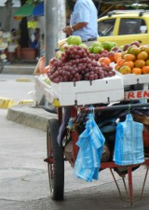
Informality, Development, and Business Cycle in North Africa
Prepared by an IMF team led by Roberto Cardarelli and including Azhin Abdulkarim, Adrian Alter, Shant Arzoumanian, Karim Badr, Hippolyte Balima, Aymen Belgacem, Olivier Bizimana, Matt Gaertner, Mahmoud Harb, Mariam El Hamiani Khatat, Chiara Maggi, Priscilla Muthoora, and Jerome Vacher

Slide 2
Background
North African economies exhibit sizable informality
Informality hinders economic development
To a certain extent, however, informality is a symptom of economic underdevelopment, and can work as a buffer against economic shocks
But informality can also be the consequence of policy distortions

Slide 3
The paper addresses three questions
To what extent is informality in North African countries explained by their level of development, as opposed to policy distortions?
What are the main policy distortions that could lead to “excess informality” in North Africa?
How does informality in North African countries impact labor markets during downturns, particularly in light of the Covid-19 crisis?

Slide 4
Informality in North Africa: Stylized Facts

Slide 5
Informality in North Africa: Stylized Facts
Measuring Informality

Slide 6
Measuring informality
Informality in NA: Stylized Facts
  Informality is defined around three key dimensions in the literature
      Informal sector: unincorporated enterprises not registered
      Informal employment: based on the characteristics of the job
      Informal economy: economic activities not covered or insufficiently covered by formal arrangements
  This paper looks at a series of commonly used indicators of informality:
      The Schneider index: share of production hidden from official authorities
      The share of informal employment in total employment
        Share of workers not contributing to a retirement pension scheme
        Share of self-employed workers

Slide 7
Informality in North Africa: Stylized Facts
Informality in North Africa

Slide 8
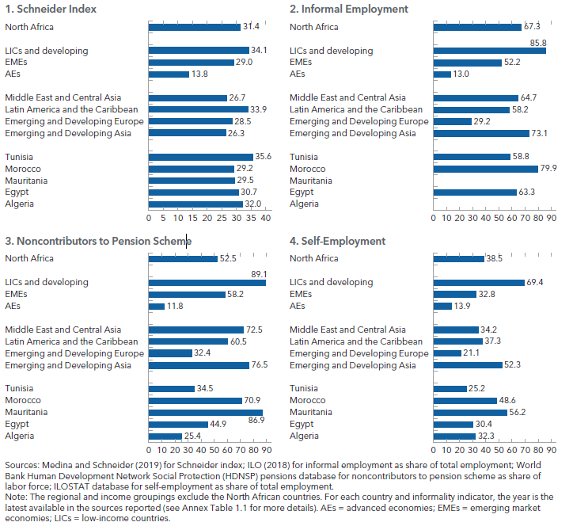
North Africa generally exhibits relatively high informality based on these indicators
Informality in NA: Stylized Facts

Slide 9
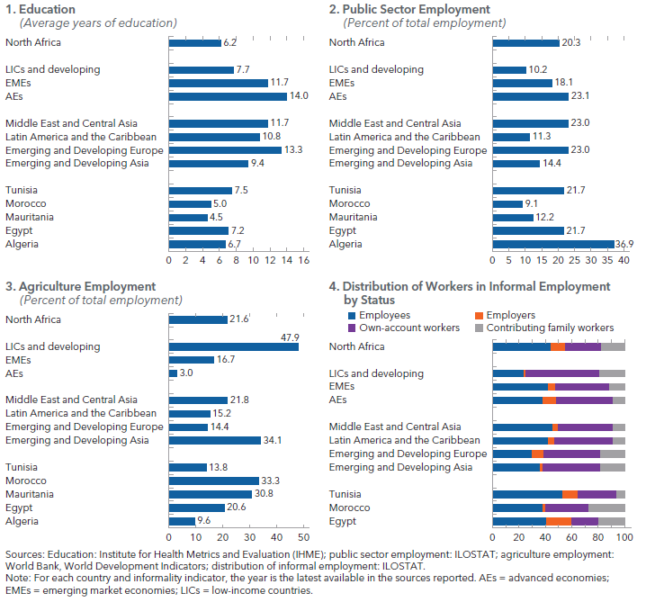
The level of informality in North Africa reflect several factors.
Informality in NA: Stylized Facts

Slide 10
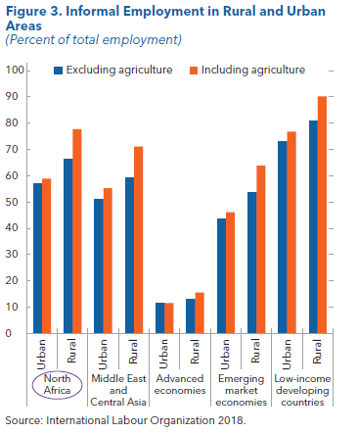
Informality in North Africa is higher in rural areas and the agriculture sector
Informality in NA: Stylized Facts

Slide 11
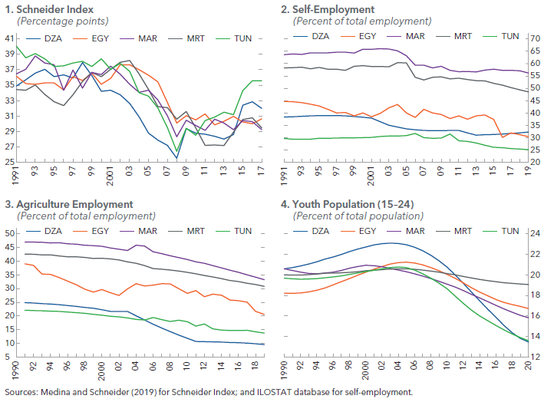
Informality trends in the region differ by indicator and country.
Informality in NA: Stylized Facts

Slide 12
Informality in North Africa: Stylized Facts
Characteristics of Informal Workers

Slide 13
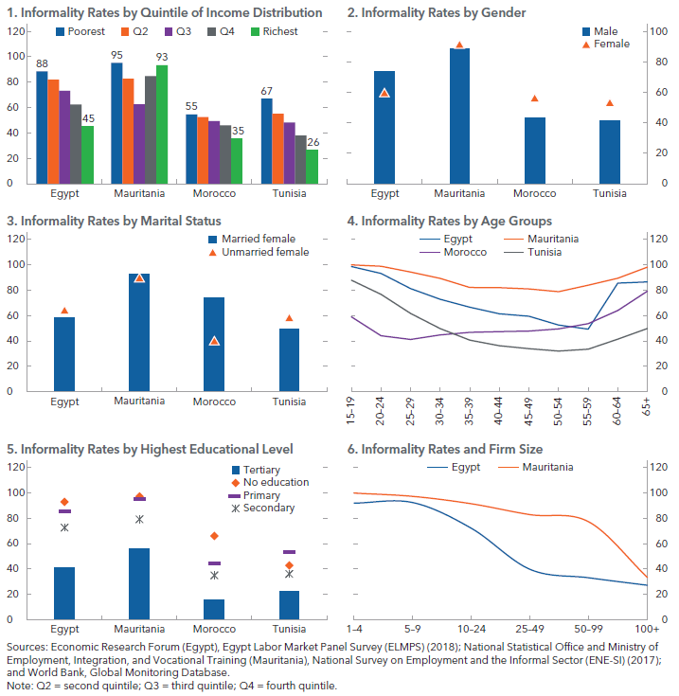
Characteristics of informal workers in North African countries

Slide 14
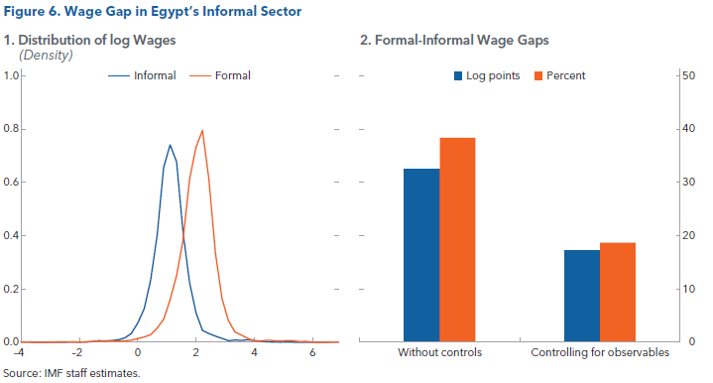
A large wage gap exists between informal and formal workers.
Informality in NA: Stylized Facts

Slide 15
To what extent is informality in North Africa countries explained by their level of development, as opposed to policy distortions?

Slide 16
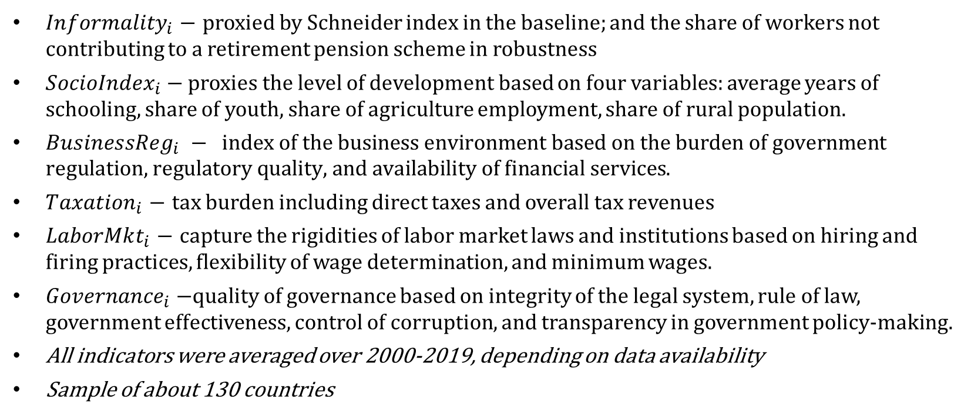
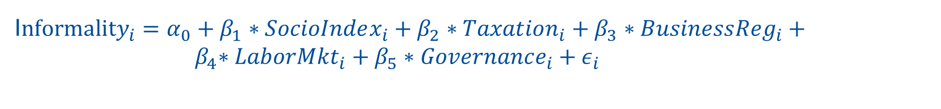
Explaining informality: Structural (“level of development”) characteristics vs “policy distortions”
Level of development vs “policy distortions”
I$nformality_{i}=α_{0}+β_{1}∗SocioIndex_{i}+β_{2}∗Taxation_{i}+β_{3}∗Business{Reg}_{i}+{ β}_{4}∗LaborMkt_{i}+β_{5}∗Governance_{i}+ε_{i}$
$Informality_{i}$ $−$ proxied by Schneider index in the baseline; and the share of workers not contributing to a retirement pension scheme in robustness
$SocioIndex_{i}−$ proxies the level of development based on four variables: average years of schooling, share of youth, share of agriculture employment, share of rural population.
$Business{Reg}_{i} − \text{index} \text{of} \text{the} \text{business} \text{environment} \text{based} \text{on} \text{the} \text{burden} \text{of} \text{government} \text{regulation}\text{,} \text{regulatory} \text{quality}\text{, }\text{and} \text{availability} \text{of} \text{financial} \text{services}$.
$Taxation_{i}$ $−$ tax burden including direct taxes and overall tax revenues
$LaborMkt_{i}$ $−$ capture the rigidities of labor market laws and institutions based on hiring and firing practices, flexibility of wage determination, and minimum wages.
$Governance_{i}$ $−$quality of governance based on integrity of the legal system, rule of law, government effectiveness, control of corruption, and transparency in government policy-making.
All indicators were averaged over 2000-2019, depending on data availability
Sample of about 130 countries

Slide 17
Regression results
Level of development vs “policy distortions”

Slide 18
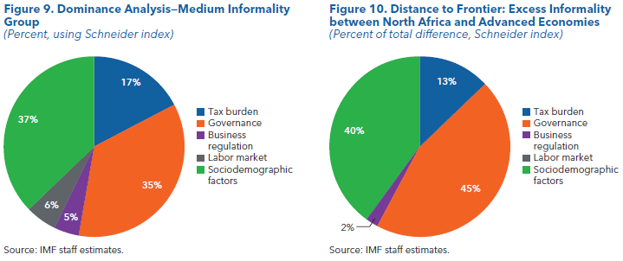
Policy distortions contribute significantly to the predicted output informality in North Africa.
Level of development vs “policy distortions”

Slide 19
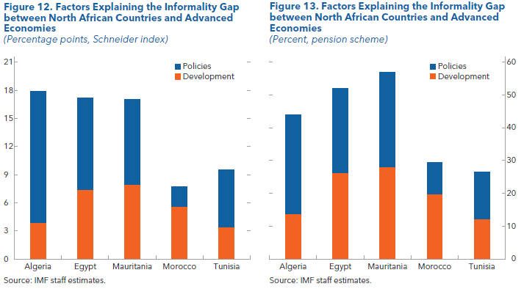
A decomposition for North African economies confirms the significant role played by policy gaps.
Level of development vs “policy distortions”

Slide 20
Policies to reduce informality: a model approach

Slide 21
What is the role of policies? A GE model of informality for Morocco
What policy distortions?
Firms and households’ choice between formal and informal sector depends on : (i) entry costs, (ii) payroll taxes, (iii) hiring costs
    Entry in formal sector occurs only if the firm’s expected profits are at least equal to entry costs
    Hiring costs affect firms’ profits and discourage formality.
    Payroll taxes affect the labor supply decision of households, firms’ demand for formal labor, and equilibrium wages. Higher taxes make formal sector less attractive.
The model is used to investigate the role of structural reforms in reducing informality and boost growth in the long run. To do that, we run four different simulations: (a) one where entry costs in the formal business sector are reduced by half, (b) one where payroll taxes for formal workers are cut by 50 percent; (c) hiring costs for formal workers are 50 percent lower; (d) and finally a scenario where entry costs, payroll taxes and hiring costs are all simultaneously reduced by 50 percent.

Slide 22
What policy distortions?
Reducing payroll taxes has the greatest impact on Morocco, but largest effect from trying all reforms
Two channels in the model:
Direct Channel: for given GDP, lower bottlenecks increase profitability of being formal and so entry in formal sector.
Indirect Channel: more entry in formal sector increases GDP, further increasing entry in formal sector (from quasi linearity of preferences).
Variable | Baseline | Lower EC (-50%) | Lower HC (-50%) | Lower PT (-50%) | Flexible Equilibrium (-50% all bottlenecks)
Real GDP | - | + 5.6% | + 1.5% | + 8.9% | +19.3%
Labor Informality Share | 63% | Direct: 59.4% Total: 58.7% | Direct: 61.8% Total: 61.6% | Direct: 50.9% Total: 49.8% | Direct : 45.8% Total : 44.4%
    Reduction in entry costs is the most successful at reducing informality
    The direct channel drives almost the whole total effect
    A 50% reduction in all bottlenecks simultaneously reduces informality by 19% (from 47% to 38%)

Slide 23
Does informality help NA economies buffer negative economic shocks? Can it slow the recovery from the pandemic crisis?

Slide 24
Okun’s law: unemployment responds less to output in countries with larger informal sectors
Informality and the business cycle
$$u_{t}−u_{t}^{∗}= β^{g}\left(y_{t}−y_{t}^{∗}\right)+ε_{t}$$

Slide 25
Informal employment is countercyclical: regression analysis
Informality and the business cycle

Slide 26
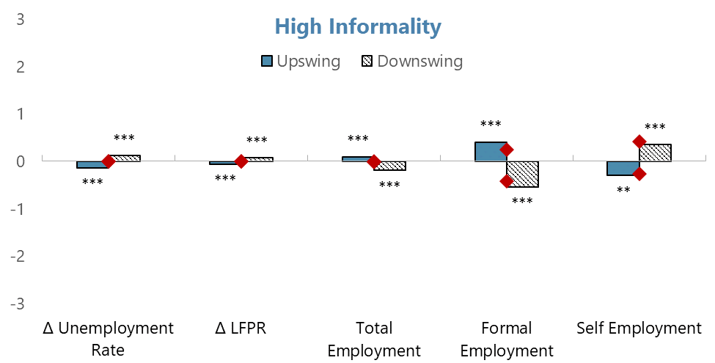
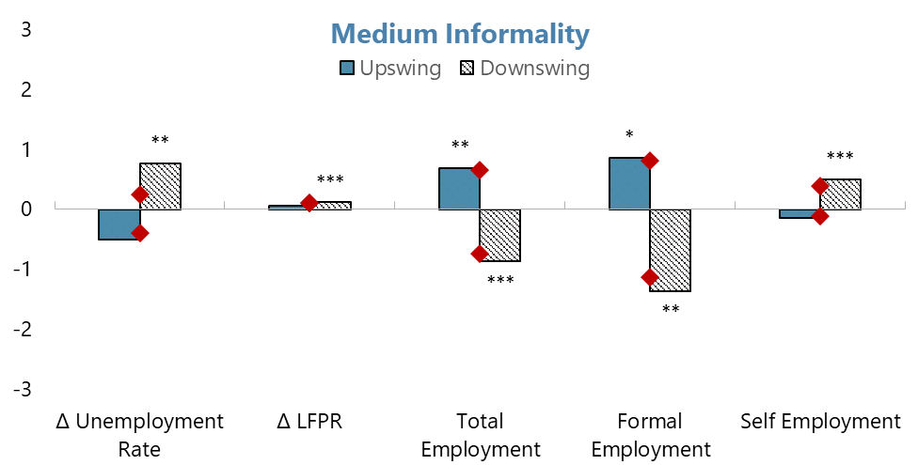
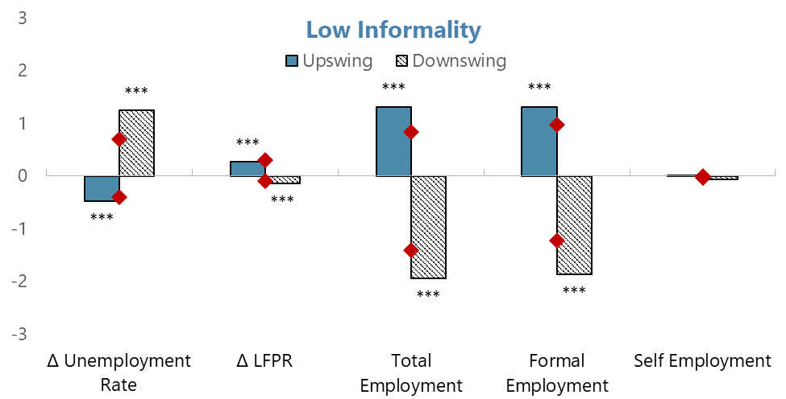
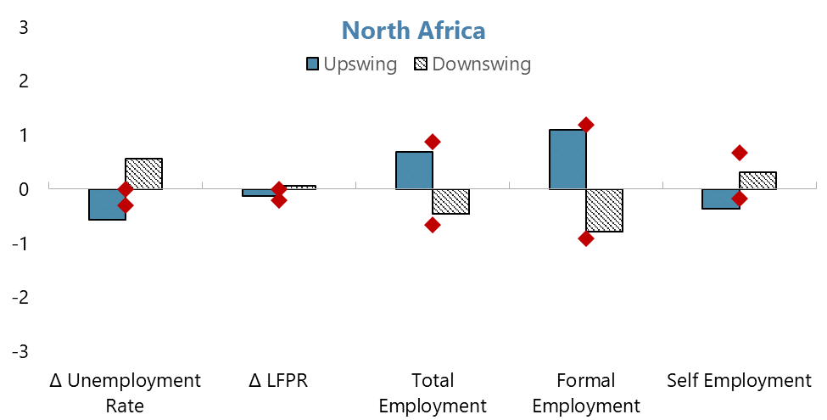
Event analysis: in upswings, countries with higher informality experience a slower rebound in employment
Informality and the business cycle
Source: IMF staff estimates.
Note: The bars represent averages for upswings and downswings, while the red diamonds represent the median.

Slide 27
The pandemic crisis is different: informality did not act as a buffer
Informality and the business cycle

Slide 28
Conclusions

Slide 29
Main points
The high level of informality in NA can be partly explained by a few key structural characteristics of these economies
However, a significant part of informality in NA is associated with policy distortions
Coordinated reforms to remove various policy distortions have the greatest impact on reducing excess informality.
Informality has traditionally buffered regional labor markets against the impact of recessions: but the pandemic crisis has been different

