Slide 1

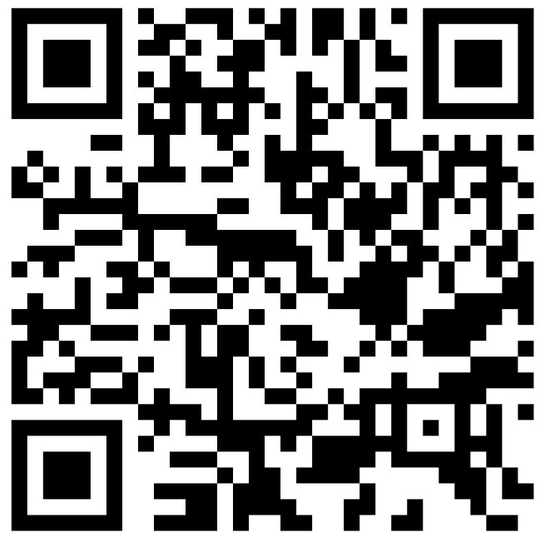
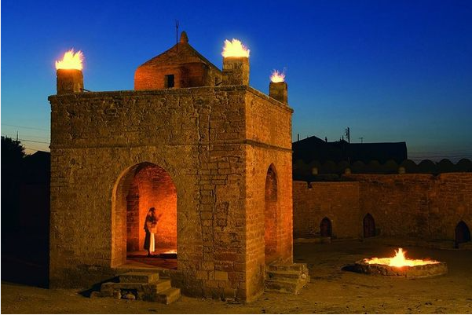
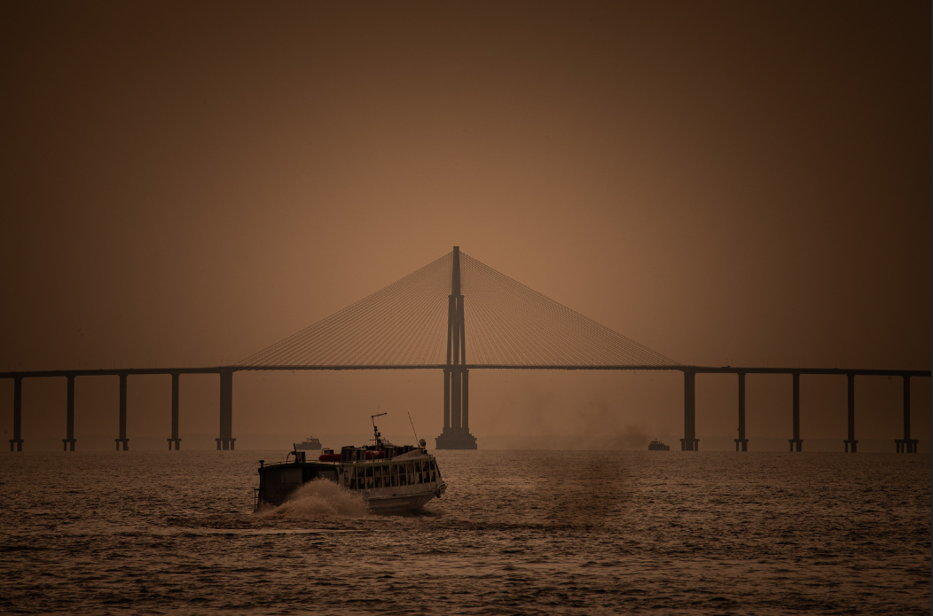
Managing Fiscal Risk in the Middle East and North Africa
Fiscal Affairs and Middle East and Central Asia Departments
January 23, 2024

Slide 2
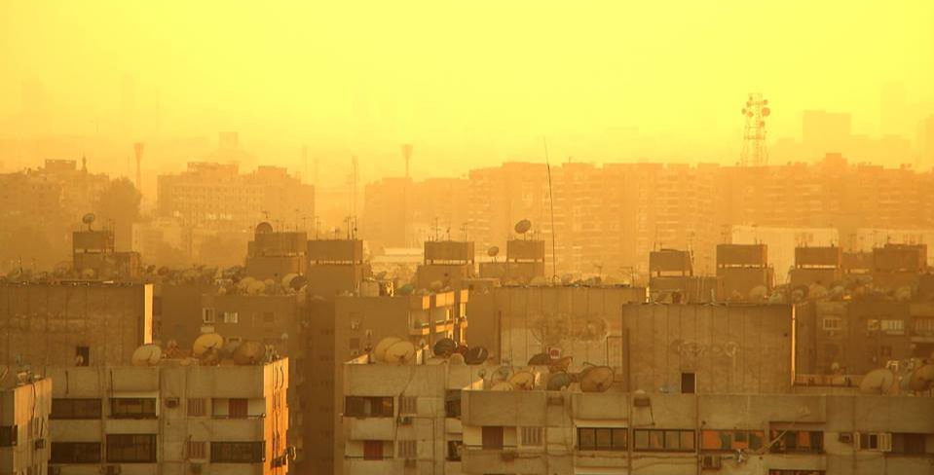
Outline: Fiscal risks…
What are they?
What are their sources?
What can be done?

Slide 3
Outline: Fiscal risks…
What are they?
What are their sources?
What can be done?

Slide 4
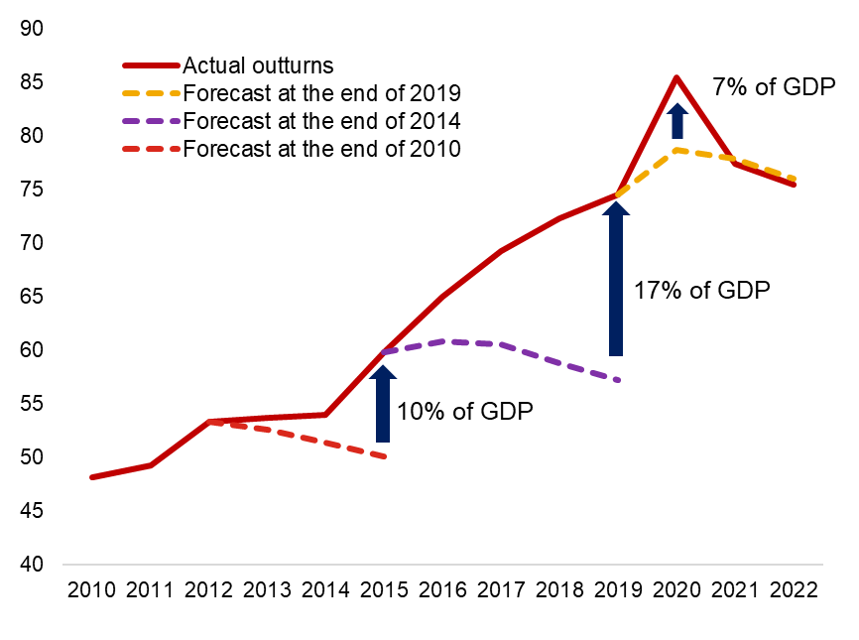
A conceptual framework for fiscal risks – what are they?
Gross Debt
(Regional average)
Macroeconomic shocks
Growth
Commodity prices
Exchange rates
Interest rates
Fiscal Risks
Tail-risk events
Social instability and conflict
Natural and climate disasters
Pandemic
Contingent liabilities
Explicit/implicit
SOEs, SOBs
Guarantees
PPPs
Sources: World Economic Outlook, October vintages from 2010 to 2022; and IMF staff calculations.
Note: The country sample covered in the paper includes the Islamic Republic of Afghanistan (AFG), Algeria (DZA), Djibouti (DJI), Arab Republic of Egypt (EGY), Iraq (IRQ), Jordan (JOR), Lebanon (LBN), Libya (LBY), Islamic Republic of Mauritania (MRT), Morocco (MAR), Pakistan (PAK), Somalia (SOM), Sudan (SDN), Syrian Arab Republic (SYR), Tunisia (TUN), West Bank and Gaza (WBG), and the Republic of Yemen (YEM). These countries are the members of the IMF Middle East Technical Assistance Center (METAC).
What are they?
What are their sources?
What can be done?

Slide 5
Outline: Fiscal risks…
What are they?
What are their sources?
What can be done?

Slide 6
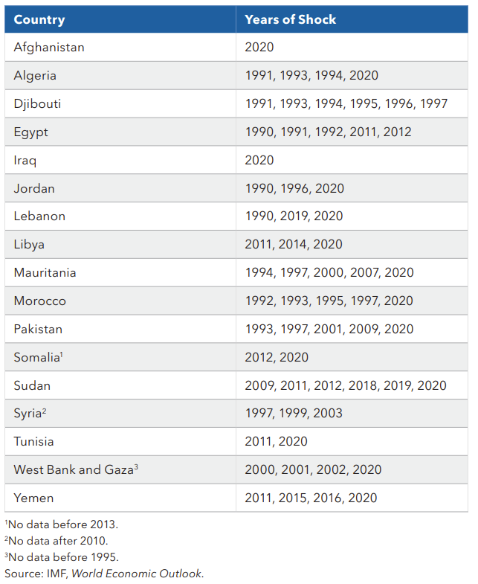
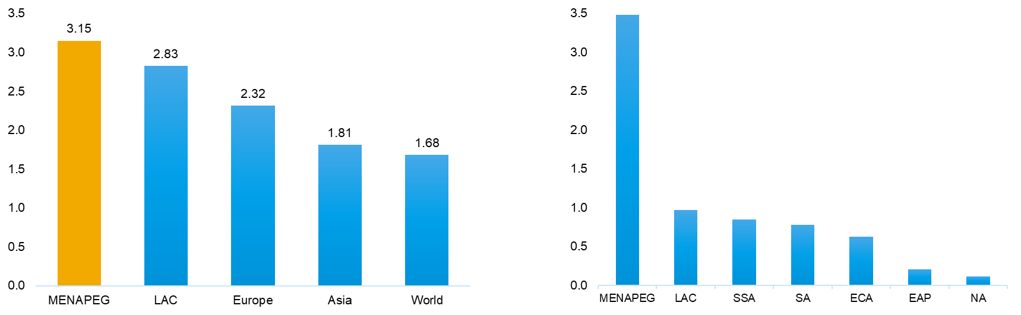

Sources of Fiscal Risk: (i) Macroeconomic shocks
61 macroeconomic shock episodes identified in MENAPEG between 1990 and 2021
Volatility of Real Growth, 1990-2021
(Standard deviation)
Sources: IMF, World Economic Outlook October 2022; IMF Country-Level Subsidy Estimates Database, 2020; and IMF staff calculations.
What are they?
What are their sources?
What can be done?

Slide 7
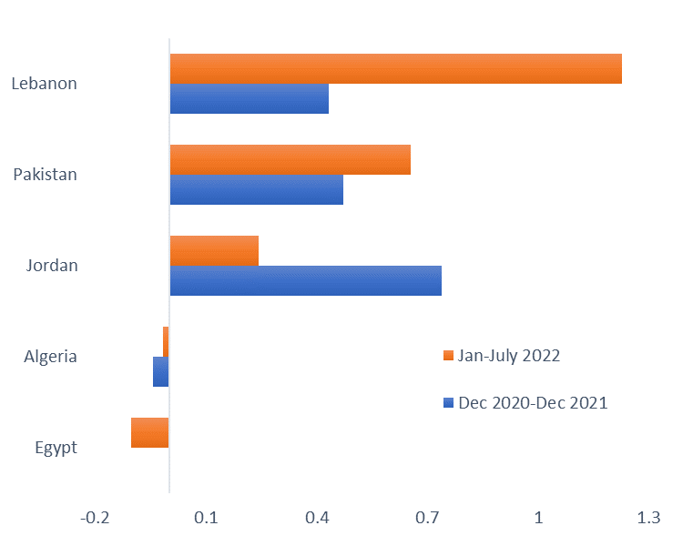
Sources of Fiscal Risk: (i) Macroeconomic shocks
Commodity prices are major triggers of fiscal risks in MENAPEG.
Total Explicit Energy Subsidies by Region, 2020
(Percent of regional GDP)
Price Pass-Through For Diesel
Sources: IMF, Primary Commodity Price System; IMF October 2022 World Economic Outlook; IMF Country-Level Subsidy Estimates Database, 2020; and IMF staff calculations.
Notes: LHS chart: Pass-through=Δ domestic retail fuel prices ($)/Δ in international fuel prices ($) over the same period with one month lag.
RHS chart: Explicit subsidies refer to “pre-tax” subsidies and occur when the retail price is below supply cost. ECA = Europe & Central Asia; EAP = East Asia & Pacific; LAC = Latin America and the Caribbean; SA = South Asia; NA = North America; SSA = sub-Saharan Africa.
What are they?
What are their sources?
What can be done?

Slide 8
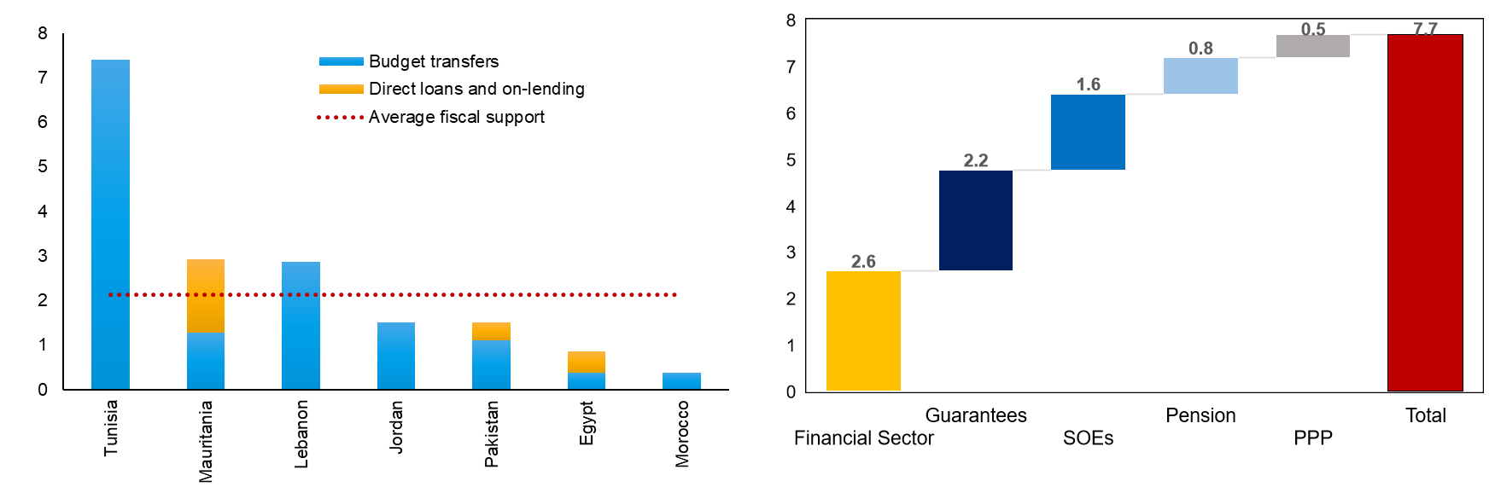
Sources of Fiscal Risk: (ii) Contingent liabilities
Large SOE sectors, state-owned banks, guarantees, and PPPs expose governments to sizeable contingent liabilities.
Direct Fiscal Support to SOEs, 2019
(Percent of GDP)
Budgetary Impact of Contingent Liabilities
(Cumulative 1990-2018, percent of GDP)
Sources: October 2020 IMF, World Economic Outlook; National authorities; and IMF staff calculations.
Note RHS chart: Contingent liability realizations pertaining to state-owned enterprises include on-budget support measures and exclude o-budget subsidies. The impact of contingent liability realizations refers to the gross payout associated with a contingent liability realization, which captures immediate budgetary pressures and excludes any asset recoveries which are associated with the realization. PPP = public-private partnership SOEs = state-owned enterprises.
What are they?
What are their sources?
What can be done?

Slide 9
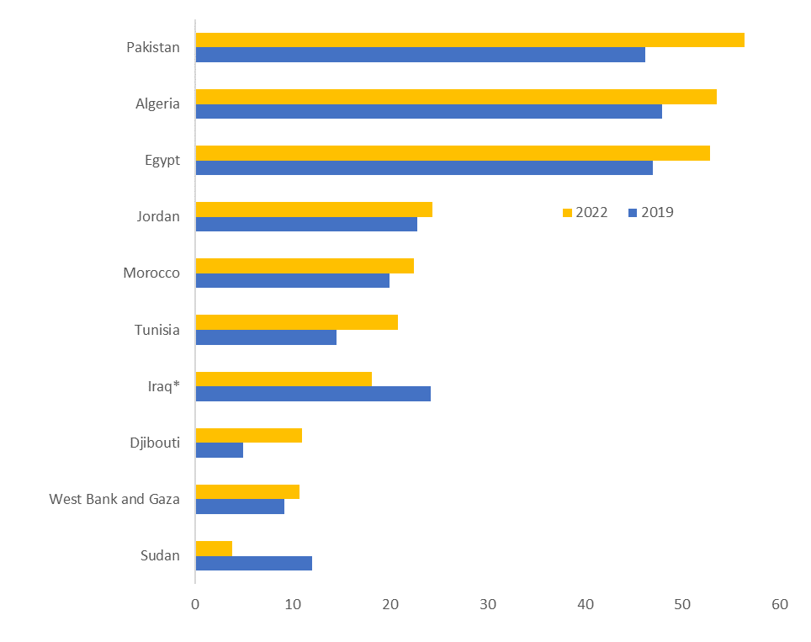
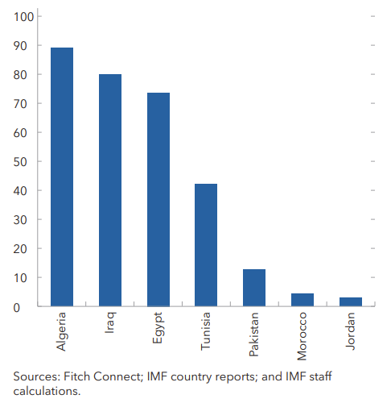
Sources of Fiscal Risk: (ii) Contingent liabilities
The sovereign-bank nexus has aggravated in several countries in recent years.
Share of State-Owned Banks in Total Bank Assets, 2022 (Percent)
Claims on General Government per Total Assets (Percent)
Sources: Fitch Connect; IMF country reports; IMF (IFS); and IMF staff calculations.
Note RHS chart: Data for Iraq is up to 2021.
What are they?
What are their sources?
What can be done?

Slide 10
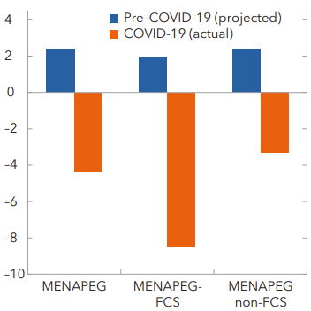
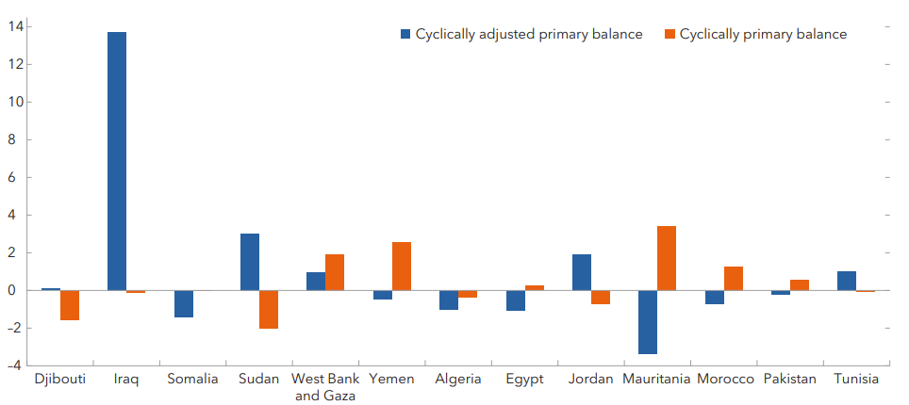
Sources of Fiscal Risk: (iii)Tail-risk events
The macroeconomic impact of the COVID-19 Pandemic
Estimated Growth Losses, 2020
(Median, percent)
Primary Balance
(Percent of potential GDP, change 2020–21)
Sources: October 2019 and April 2022 World Economic Outlook; and IMF staff calculations.
Note LHS chart: Data for Algeria and Iraq exclude hydrocarbon revenue and hydrocarbon GDP. Syria and Libya are excluded due to lack of data.
Afghanistan and Lebanon are excluded due to lack of data for 2021
What are they?
What are their sources?
What can be done?

Slide 11
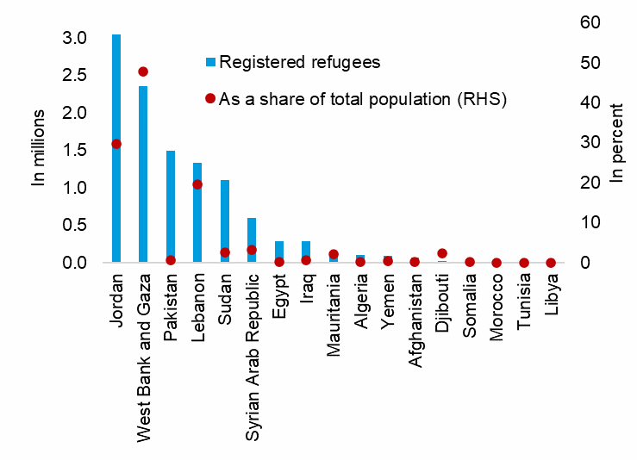
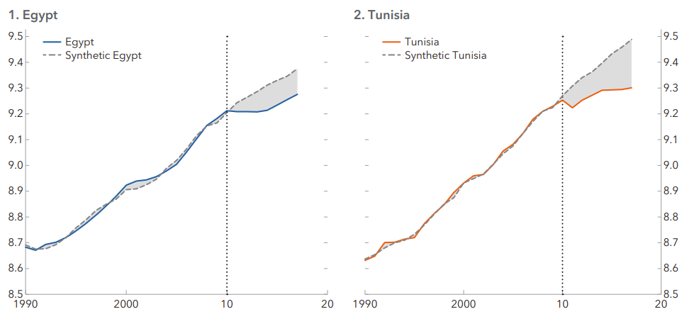
Sources of Fiscal Risk: (iii) Tail-risk events
Social unrest and instability have led to large economic and fiscal costs in the region.
Refugee Population Residing in MENAPEG
(By Country or Territory of Asylum, 2021)
Estimated Post Arab Spring Cumulative Output Losses in Egypt and Tunisia
(Natural logarithm, GDP per capita PPP, constant 2011 US dollars)
Sources: World Bank, World Development Indicators; UNHCR; UNRWA; Emergency Events database; World Bank, World Development Indicators; and authors’ calculations.
Note RHS chart: output losses estimated by creating a synthetic GDP following the methodology of Matta, Appleton, and Bleaney (2019).
What are they?
What are their sources?
What can be done?

Slide 12
Outline: Fiscal risks…
What are they?
What are their sources?
What can be done?

Slide 13
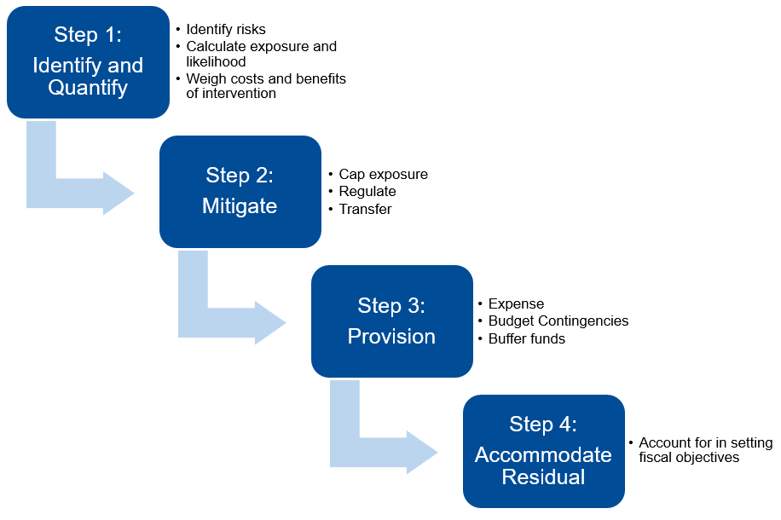
A sound and comprehensive framework is a critical to manage fiscal risks
Fiscal Risk Management Strategy
Sources: IMF (2016a); and International Monetary Fund, the Fiscal Transparency Code.
What are they?
What are their sources?
What can be done?

Slide 14
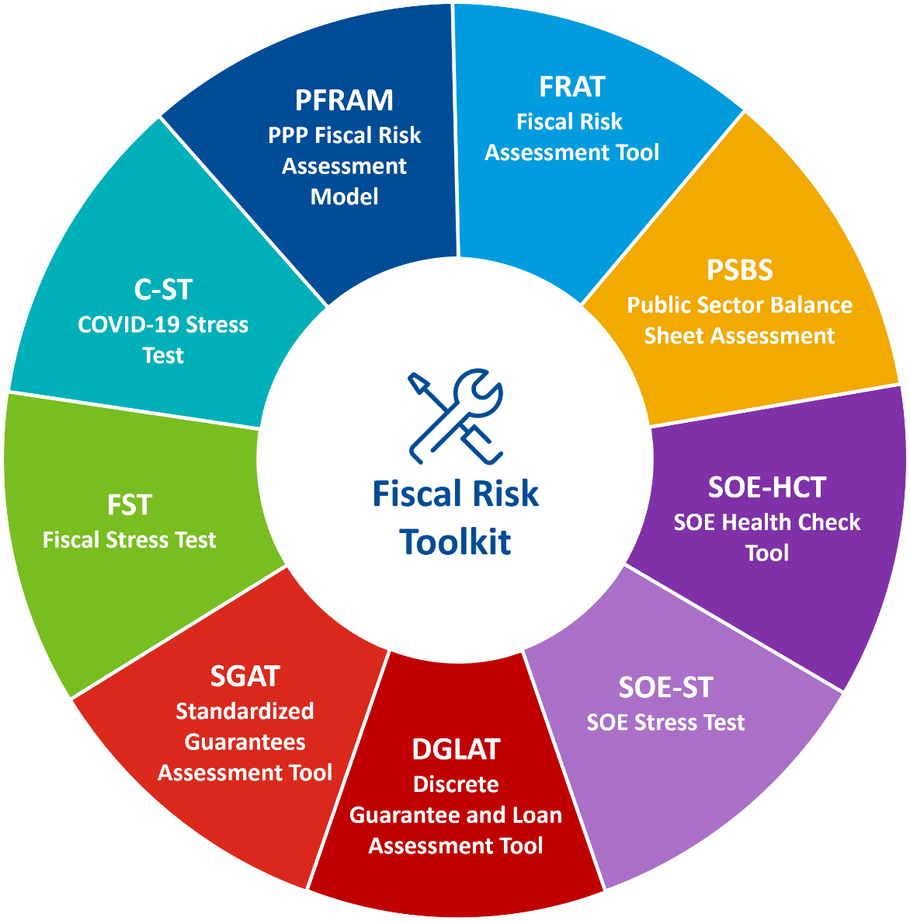
The IMF’s fiscal risk toolkit supports risks analysis …
Additional climate tools under development
PANDA-T: Pandemic and natural disaster
QCRAFT: Quantifying climate change fiscal risks
What are they?
What are their sources?
What can be done?

Slide 15
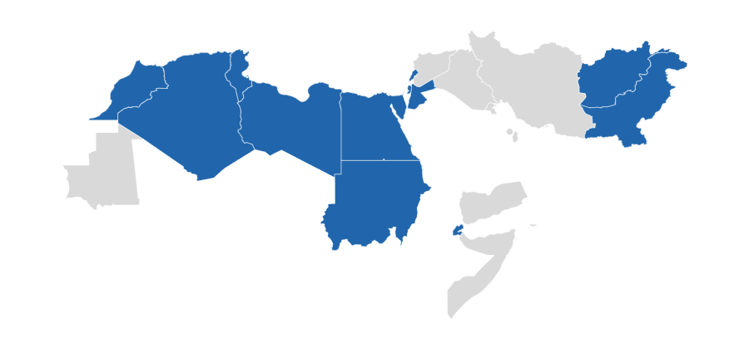
Several countries are undertaking reforms: To strengthen institutional arrangements …
Selected countries in the region are developing medium-term fiscal frameworks and fiscal risk management functions in Ministries of Finance
TUN
LBN
MAR
WBG
AFG
PAK
DZA
LBY
JOR
EGY
SDN
DJI
What are they?
What are their sources?
What can be done?

Slide 16
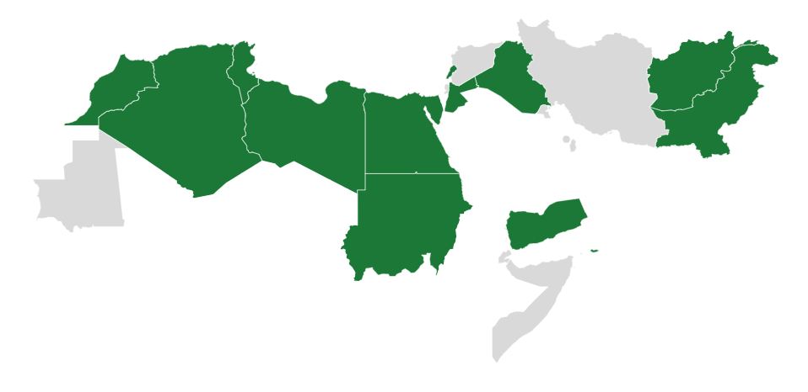
… and improve analysis, management, and disclosure of fiscal risks
Selected countries in the region that have undertaken reforms in risk analysis, management, and disclosure of fiscal risks
TUN
SOEs, FTE
JOR
FTE, PPPs, draft FRS
SOEs & PPPs
SOEs & PPPs
Training on FR
LBN
SOEs, FRS
IRQ
AFG
MAR
PAK
DZA
LBR
EGY
Guarantees
FRAT
SOEs, PPPs
SDN
YMN
Training on FR
PPPs, guarantees, SOEs, disclosure
SOEs
FRAT = Fiscal Risk Assessment Tool, FRS = Fiscal risk statement, FTE = Fiscal transparency evaluation, PPPs = Public private partnerships, SOEs = State-owned enterprises
What are they?
What are their sources?
What can be done?

Slide 17
… but the region continues to lag in fiscal transparency
Performance on selected questions in the Open Budget Survey
Sources: 2021 Open Budget Survey and Fiscal Transparency Evaluations (Open Budget Survey - International Budget Partnership).
WE = Western Europe, US = United States, CA = Canada, EAP = East Asia and the Pacific, LAC = Latin American and the Caribbean
Note: The boundaries and names shown, and the designations used on this map do not imply official endorsement or acceptance by the United Nations. Final boundary between the Republic of Sudan and the Republic of South Sudan has not yet been determined. Regarding Line of Control in Jammu and Kashmir agreed upon by India and Pakistan, the final status of Jammu and Kashmir has not yet been agreed upon by the parties.
What are they?
What are their sources?
What can be done?

Slide 18
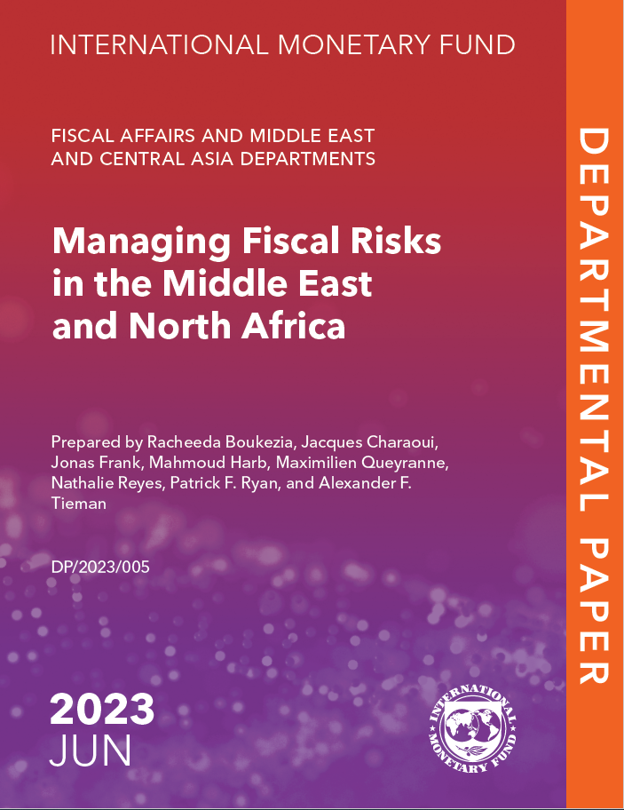
Thank you!

