Slide 1
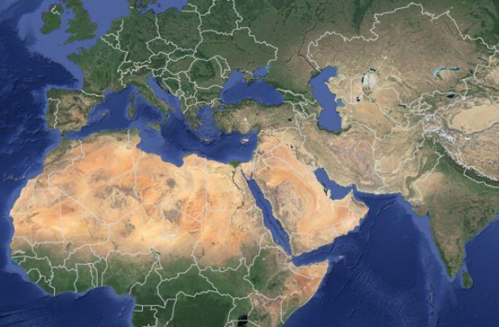
Fostering Private Sector Led Growth in MENA:
A New Role for the State
September 2023
Suchanan Tambunlertchai, Monica Petrescu (both IMF), Mahdi Ansari (UMN)

Slide 2
Outline
Background: Large footprint of the state in MENA economies, particularly through myriad of SOEs.
Empirical evidence: How do SOEs differ from private sector firms? How does SOE presence affect private sector dynamics?
Policy implications: New role of the state to facilitate competition and business dynamism.
Chapter in “Promoting Inclusive Growth in the Middle East and North Africa”

Slide 3
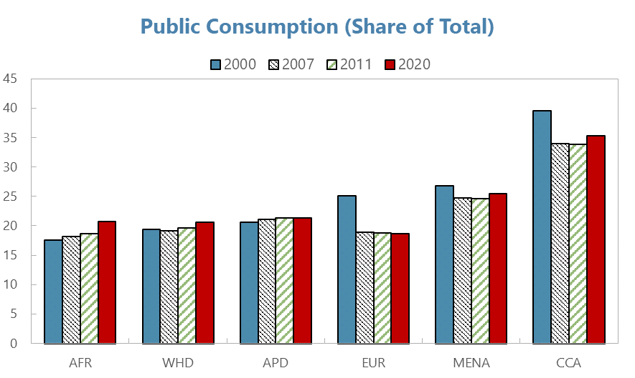
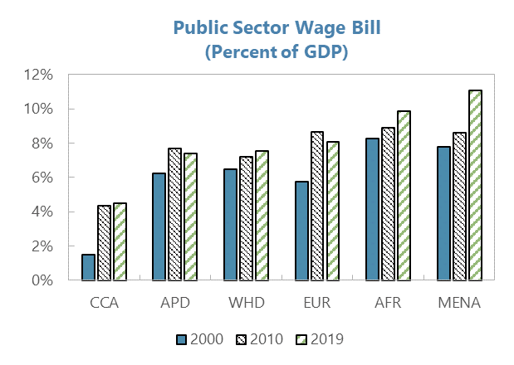
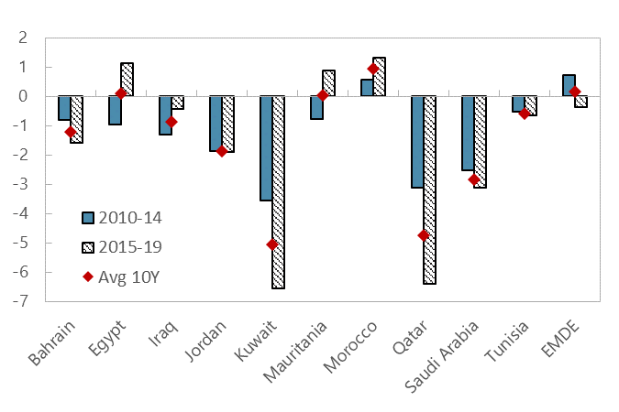
Development models based on state capitalism left large state footprints in MENA, and may be reaching their limits
The share of public consumption in MENA is sizeable…
… and the public wage bill is highest among world regions.
Productivity has been declining across the region.
Public Consumption
(Share of total)
Public Sector Wage Bill
(Percent of GDP)
Total Factor Productivity Growth
(Percent year-on-year)
Sources: World Economic Outlook; Penn World Table 9.1 and IMF staff calculations National Accounts and IMF staff calculations.
Note: AFR= Sub-Saharan Africa; WHD = Western Hemisphere; APD= Asia and Pacific; CCA = Caucasus and Central Asia; EMDE = Emerging market and developing economies.

Slide 4
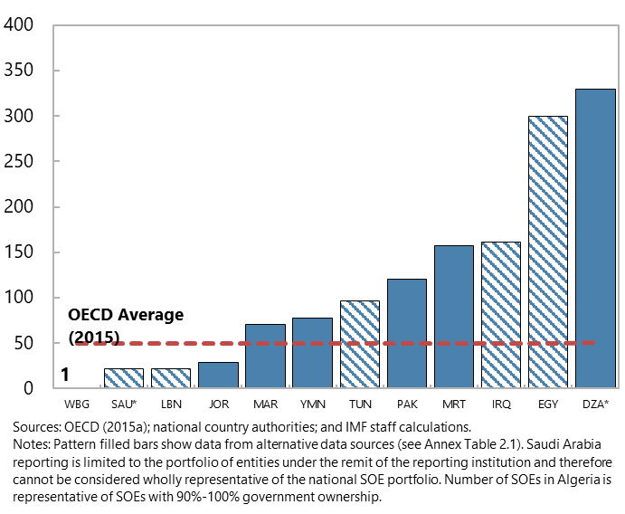
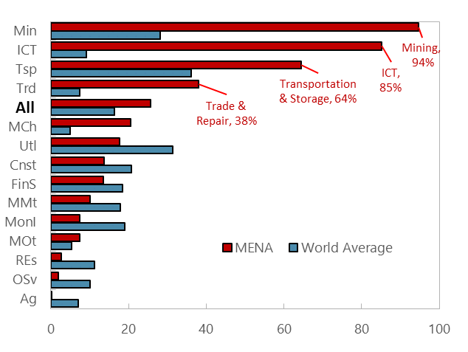
Disproportionately high number and market presence of SOEs across many sectors in MENA
Large number of SOEs in MENA compared to peers.
MENA SOEs especially active in trade, transport, ICT, and mining.
Number of SOEs
(2019 or latest available)
Sectoral Asset Share of SOEs
(2006-2018 average)
Sources: Orbis and IMF staff calculations.
Note: Note. Ag = Agriculture; Cnst = Construction; FinS = Other Financial Services; MCh = Chemicals Manufacturing; MMt = Other Materials Manufacturing; MOt = Other Manufacturing; Min = Mining; MonI = Monetary Intermediation; OSv = Other Services; Res = Real Estate; Trd = Trade & Repair; Tsp = Transportation & Storage; Utl = Utilities & Sanitary; Whole = All sectors.

Slide 5
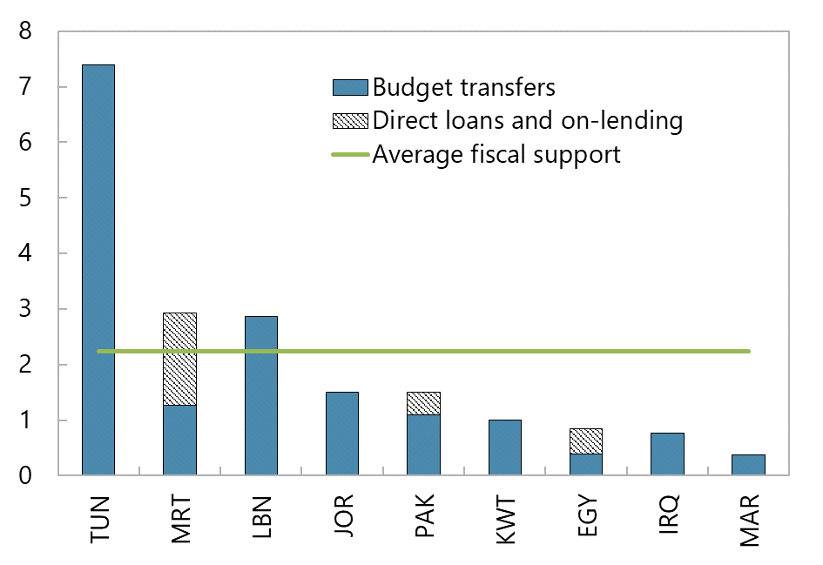
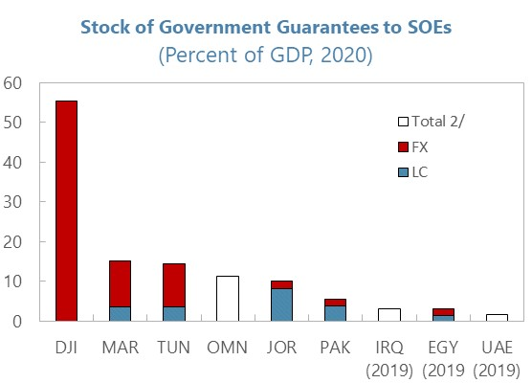
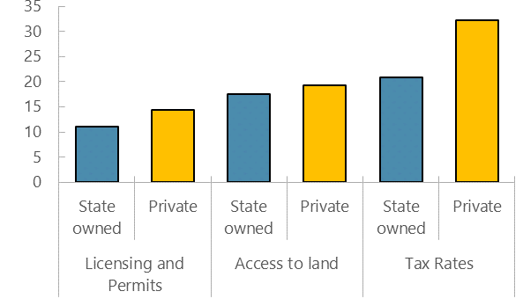
SOEs benefit from fiscal and administrative advantages
Direct fiscal support to SOEs is significant across the region…
… and government guarantees can be sizeable.
SOEs report facing fewer difficulties with permits, access to land, or taxes.
Direct Fiscal Support to SOEs
(2019, percent of GDP)
Stock of Government Guarantees to SOEs
(2020, as percent of GDP)
Obstacles Reported by Firms
(percent of firms reporting as major constraint)
Sources: “State-Owned Enterprises in Middle East, North Africa, and Central Asia: Size, Costs, and Challenges”, IMF 2020; and WB Enterprise Surveys.

Slide 6
Advantages received by SOEs may create distortions and affect private sector development
SOE Advantages
Impact on private sector
Administrative advantages (ability to bypass red tape)
Inefficient allocation of resources
Large capital and market share upon entry
Reduced competition in input and output markets
Cheaper and more ample access to credit
Reduced private sector investment
Reduced entry/dynamism

Slide 7
Quantifying the relationship between SOEs and private sector firms
  Methodology: empirical analysis using firm-level balance sheet data from Orbis; panel of annual data (2006-2018) with more than 50 million observations in 74 countries.
  1. How do SOEs differ from private sector firms?
      Interest costs; profitability.
  2. Do these differences suggest resource misallocation?
      Productivity in use of resources.
  3. How does the presence of SOEs affect competition, business dynamism and private sector investment?

Slide 8
Differences between SOEs and private sector firms suggest potential resource misallocation
Consistent with better access to credit, SOEs face lower interest costs (0.3 percentage points) than private sector counterparts.
SOEs are also less profitable than private sector counterparts.
In MENA, SOEs are also less productive in using capital than their private sector counterparts, which, combined with lower interest rates, suggest resource misallocation.
Note: Robust standard error in parentheses. *** p<0.01, ** p<0.05, * p<0.1
Firm and sector level controls include firm size, age, leverage, current asset ratio, equity ratio, and stock turnover, and interactions between SOE and firm age and size. Sectoral controls include market concentration, entry rate, and investment rate.

Slide 9
A larger SOE presence reduces competition through higher market concentration
SOE presence measured as share of total assets in a sector held by SOEs
Larger SOE presence associated with higher concentration in output markets globally (with the relationship significantly stronger in MENA)
Larger SOE presence associated with higher concentration in input markets (both capital and labor) in MENA
Note: SOE share represents share of sector assets owned by SOEs.
Robust standard error in parentheses. *** p<0.01, ** p<0.05, * p<0.1

Slide 10
A larger SOE presence reduces private sector dynamism and investment
Larger SOE presence is associated with reduced business dynamism (lower entry and exit rates) for private sector firms.
Larger SOE presence is also associated with lower investment by private sector firms in MENA.
Note: SOE share represents share of sector assets owned by SOEs. Entry (exit) represent share of first in the first (last) year.
Robust standard error in parentheses. *** p<0.01, ** p<0.05, * p<0.1

Slide 11
Conclusions
SOEs differ from private sector firms:
  Benefit from certain advantages, e.g., lower interest rates;
  Less profitable and less productive.
Higher SOE presence in a sector is associated with:
  Lower competition in input and output markets;
  Lower dynamism;
  Lower private investment.

Slide 12
Policy Implications
  Rolling back the state’s role can lead to greater efficiency, higher productivity, and hence strengthen the economy’s ability to sustain higher growth; in MENA, state should pivot towards facilitating (rather than leading) business activities.
  Improving governance, transparency, and accountability for SOEs could help improve SOE efficiencies.
  Need for a competition and labor market policies that ensure competitive neutrality between public and private sectors and encourage private sector participation.
  Reducing barriers to entry/costs of doing business, e.g., by streamlining business licensing requirements.
  Labor market policies that facilitate labor reallocations from public sector and low-productivity services to more productive sectors.

Slide 13
Thank you!

Slide 14
Back up slides

Slide 15
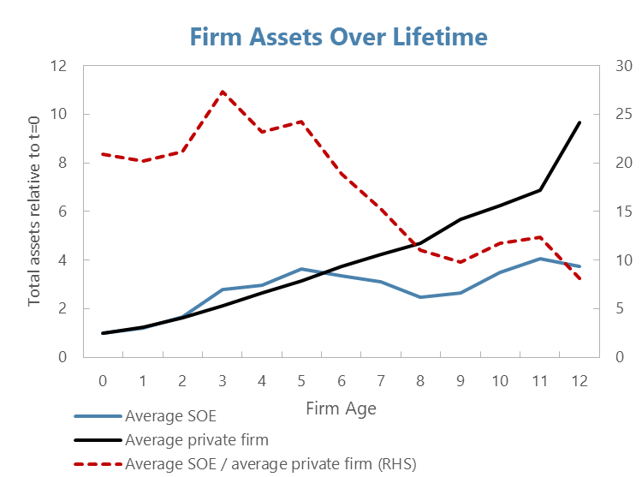
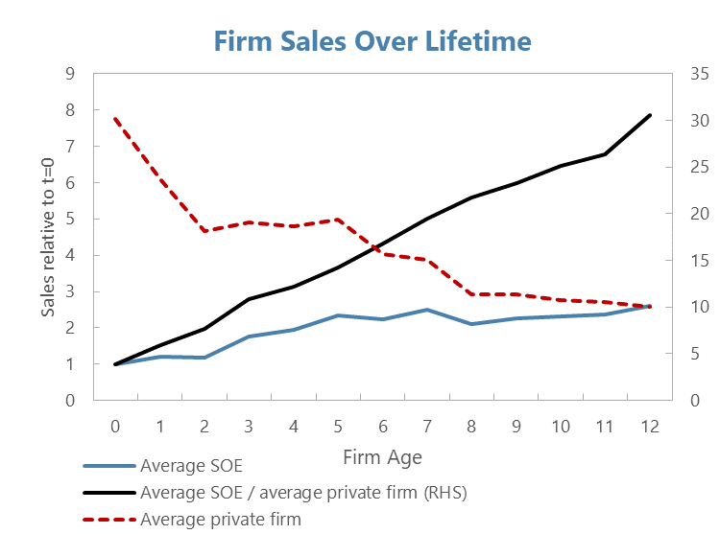
Different life cycle dynamics for SOEs vs. private firms
SOEs are larger in size upon establishment, in terms of both assets and sales, but grow more slowly than private sector firms
Sources: IMF analysis of Orbis data.

