Slide 1



Middle East and Central Asia Regional Economic Outlook Monetary Policy: Where Does ME&CA Stand?
iStock.com/Hasan Zaidi
Placeholder for images
iStock.com/DinoGeromella
MaY 23, 2023
Middle East and Central Asia Department
iStock.com/Mlenny
Notes:
Photo 1: Qatar World Cup build up (the count-down clock)
Photo 2: Local grocery market Fez Morocco
Photo 3: Uzbekistan (Kukeldash Madrasa, Tashkent)
Thank organizers + invite to read the chapter

Slide 2
Outline
Monetary Policy Instruments and Recent Actions
Assessing the Monetary Policy Stance
Monetary Policy Transmission Mechanism
Policy Recommendations

Slide 3
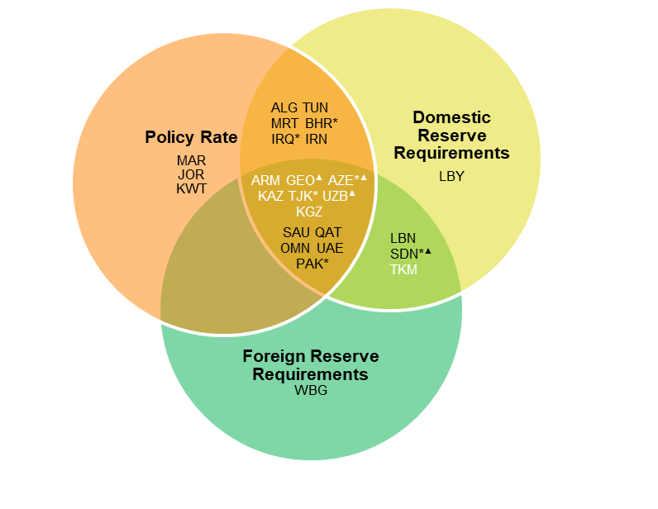
ME&CA countries tightened monetary policy, mostly by raising policy rates but lack of policy coordination could hamper efforts to lower inflation
Policy interest rates and reserve requirements are the main monetary policy instruments in the region.
Almost all central banks raised their policy rates over the past two years
Pervasive fiscal dominance could hamper central banks’ efforts to lower inflation
ME&CA Central Banks' Instruments
Change in Policy Interest Rates and Inflation
(Percentage points, January 2021 – March 2023)
Central Banks’ Net Claims on Central Government and Claims Public Non-Financial Corporations
(Percent, 2020–21 average)
Source: IMF desk survey.
Note: Country names in black font are Middle East and North Africa, and Pakistan; country names in white font are Caucasus and Central Asia. Countries with a * increased their domestic currency reserve requirements and with a ▲ increased their foreign currency reserve requirements since January 2021. ME&CA = Middle East and Central Asia.
Sources: Haver Analytics and IMF staff calculations. Note: CCA = Caucasus and Central Asia; MENA and PAK = Middle East and North Africa, and Pakistan; ME&CA = Middle East and Central Asia; rhs = right-hand scale.
Sources: IMF, International Financial Statistics database; and IMF staff calculations.
Note: The classification of which countries experienced fiscal dominance and which did not is based on IMF country teams’ assessment. See Annex 1 for details. CB = central bank; CG = central government; PNFC = public nonfinancial corporations.
Sources:
Notes:
ME&CA central banks use a variety of instruments, the dominant one being the policy rate.
2) Against the backdrop of rising inflation – with inflation in double-digits in several countries – almost all central banks have raised policy rates over the past two years.
3) Rises in policy rates have been complemented with other measures (tighter RR etc.) in some countries
Most of the region’s central banks have acted to mop up excess liquidity, for example by issuing their own securities or intervening in foreign exchange markets and selling foreign currency.
However, they have made limited use of macroprudential tools while only a few provide forward guidance on interest rates.
4) Lack of policy coordination between monetary and fiscal policies and fiscal dominance could hamper efforts to lower inflation.
These are present in about half of ME&CA countries, resulting in an inconsistent policy mix likely to thwart central bank efforts to control inflation.

Slide 4
Most ME&CA central banks have tightened interest rates more than during similar episodes in the past, and policy is estimated to be neutral or tight in most countries
Most ME&CA central banks raised interest rates in line or more than when facing similar inflation dynamics in the past….
… evidenced by policy rates above neutral in majority of countries.
Difference between Actual and Rule-based Policy Interest Rate Changes
(2021Q1−2022Q4, Percent)
Nominal Policy Interest Rates
(Percent)
Sources: IMF Staff Calculations.
Source: IMF staff calculations.
Note: The cutoff date for the policy rate changes is March 31, 2023. TVP-VAR = time-varying parameter vector autoregressions.
Notes:
Policy as of end of March-2023 is estimated to be neutral or tight in most countries using a policy rate. For this assessment, the reaction of central banks is compared to two benchmarks.
1) First, the policy response to the recent surge in inflation is compared to the past reaction of central banks in the region and to the reaction of other inflation-targeting central banks outside ME&CA. (indicated by the blue dot and red line respectively).
Countries with an inflation-targeting regime and conventional peggers have increased policy interest rates more than when facing previous shocks of comparable magnitude.
In countries with an inflation targeting regime, the central bank reaction has also been broadly consistent with the reaction of central banks in other emerging market economies with longer track records of inflation targeting (Brazil, Chile, Colombia, Mexico, and Peru). This suggests that their monetary policy response to the recent inflation surge was consistent with a steadfast commitment to fighting inflation.
Conversely, countries with other monetary frameworks (e.g. Egypt, Tunisia) have increased interest rates consistent with their historical norms and less than the EMDE benchmark. This suggests that they are less reactive to inflation developments than other peers, likely because tradeoffs between higher interest rates and debt sustainability are critical.
2) Neutral rate: the interest rate that is consistent with inflation at its target and output at potential → intuitively, the interest rate that is neither contractionary nor expansionary
Empirically: use multiple approaches
→ gives confidence in estimates despite significant uncertainty
→ Policy rates are at or above neutral in most countries as of end-of-March 2023 while some countries may need additional tightening.
Once short-term inflationary pressures are constrained, policy interest rates – currently well above estimates of terminal rates – will eventually converge to lower levels.

Slide 5
Monetary Policy Transmission Mechanism

Slide 6
Tight monetary policy lowers both inflation and output
Without higher policy rates, inflation would have been higher across the region.
Higher policy rates lower both inflation and output growth.
Peak Impulse Response of Inflation and GDP to a 100-bps Monetary Shock
(percent)
Impact of Higher Policy Rates on Inflation (Average percentage, 2021–22)
Source: IMF staff calculations.
Note: F = Floater, MP = Managed Pegger, CP = Conventional Pegger. bps = basis points; GDP = Gross Domestic Product; QoQ = quarter over quarter.
Source: IMF staff calculations.
Note: CP = conventional pegger; F = floater; MP = managed pegger.
Notes:
What is likely impact of policy rates above neutral? And how does monetary tightening reduce inflation?
LHS Figure reports peak impact of monetary policy tightening on inflation and real GDP.
The estimated effects are the largest in countries with floating exchange rates and managed pegs, while the responses are more muted for countries with pegged exchange rates, suggesting that the exchange rate channel might be key for the transmission of monetary policy for countries in the sample.
Following a surprise monetary policy tightening, a large appreciation of the nominal exchange rate was observed for all countries in the sample, and this appreciation occurs within the same quarter as the tightening. For countries with a floating or managed exchange rate, the analysis found that a 100 basis point monetary policy shock leads to an appreciation in the nominal exchange rate of almost 2 percent on an annualized basis.

Slide 7
Since 2021, interest rate tightening has translated into tighter financial conditions, also driven by external conditions
Financial conditions have tightened since 2021..
… mainly due to higher interest rates and external factors
… the impact of interest rate changes on financial conditions varies significantly across countries
ME&CA: FCI Changes versus Policy Rate Changes
(Jan. 2021 to latest)
Sources: Bloomberg Finance L.P.; Haver Analytics; national authorities; IMF, IFS database: and IMF staff calculations.
Notes:
1) Since 2021, financial conditions have tightened across ME&CA countries. This is measured using a financial conditions index that provides a comprehensive measures of financial conditions in money, debt, and equity markets and from conditions stemming from external factors.
2) The primary driver of tighter financial conditions have been higher interest rates, and to a lesser extent global factors.
3) The relationship between increases in policy interest rates and tighter financial conditions is positive but dispersed across the region. A widely diverse reaction of financial conditions to changes in policy interest rates partially reflects ME&CA central banks’ use of different instruments to tame recent inflation pressures. It is also consistent with relatively large heterogeneity in the monetary policy transmission channel.

Slide 8
Monetary Tightening is passed on into higher Interest Rates…
… and tighter credit, especially in OEs, …
… but high oil prices attenuate passthrough in OEs at current juncture.
The bank lending channel is active, but attenuated by currently high oil prices (in OEs) and low levels of financial development (OIs)
Source: IMF staff calculations.
Notes: F = Floater, MP = Managed Pegger, CP = Conventional Pegger, bl = barrel; bps = basis points; rhs = right-hand side.
Notes:
In countries with fixed exchange rates, at the peak, a 100 basis point US monetary tightening leads to 81 basis points higher asset rates (a proxy for effective lending rates), 66 basis points higher liability rates (a proxy for effective deposit rates) and a reduction of 3.2 percent in real credit growth.
These effects are weaker in countries with a floating or managed exchange rate, partly reflecting their lower levels of financial development. Additional analysis shows that monetary policy transmission is stronger in the more financially developed countries of the region.
For oil -exporting countries with a fixed exchange rate, the level of the oil price is a critical determinant of the strength of monetary transmission. When liquidity is ample because of high oil revenues, the transmission of US monetary policy into domestic financial conditions is dampened.
$82 – oil price from Jan 18, 2023
$ 65 – medium-term WEO projections
There is significant heterogeneity across the region. Additional work also shows that the passthrough is stronger in countries with a smaller footprint of state-owned banks.
Overall, the results suggest that the banking sector may be playing only a limited role in monetary transmission to the real economy for exchange rate floaters and managed peggers in the region, on average, particularly for countries where state-owned banks are dominant.

Slide 9
Policy Recommendations

Slide 10
Calibrating and communicating monetary policy in a data-dependent manner will be essential to prevent de-anchoring of inflation expectations
1
Where the policy stance is tight or neutral, and inflation appears to have peaked, (for example Armenia, Georgia) central banks should remain on hold until there are clear signs that core inflation is on a downward trajectory.
2
Countries with a currency peg should continue to follow US monetary policy and consider the use of additional macroprudential policies in case of significant asset price appreciation of if financial conditions remain loose or loosen.
3
Where the policy stance is loose and inflationary pressures persist, tighter monetary policy should be considered (for example, Egypt, Pakistan, Tunisia).
4
Where there is a lack of monetary policy and fiscal policy coordination or where there is fiscal dominance, authorities will need to address fiscal imbalances before monetary policy can become an effective tool to stabilize inflation.
5
Where high oil prices dampen the bank lending channel, the policy rate will need to be complemented with other monetary or macroprudential tools
6
Central banks should remain vigilant of financial stability risks and closely monitor financial system vulnerabilities that could arise from increasing or high-for-long interest rates.
Notes:
Frame as short-term recommendations

Slide 11
Improving Monetary Policy Frameworks and Monetary Policy Transmission in the Region
1
Financial sector development (e.g.,interbank markets, secondary markets for government securities, de-dollarization)
2
Closer coordination of monetary policy with financial and fiscal policies (e.g., level playing field between state-owned and private banks)
3
Macroprudential measures to strengthen the relation between changes in the policy rate and in financial conditions in countries with fixed exchange rates
4
Enhancing central bank communications and increasing the transparency of monetary operations and foreign exchange interventions.
5
Developing surveys of inflation expectations
Notes:
Frame as medium-term policy recommendation
e.g. fin. sector development (well-functioning and highly liquid interbank markets for reserves + secondary markets for government securities with a broad range of maturities + measures to de-dollarize) This would subsequently facilitate greater exchange rate flexibility, allowing the exchange rate to act as a shock absorber to better isolate economies from shocks and improve the efficiency of monetary policy.
e.g. reducing quasi-fiscal and quasi-monetary actions of SOBs, including phasing out quasi-fiscal activities and subsidized lending

Slide 12
Thank you!

Slide 13
ME&CA banks engaged in measures to mop up excess liquidity while usage of macroprudential tools and forward guidance was limited
The region’s central banks also took other actions to tame inflation over the past two years …
… amidst a limited use of macroprudential tools…
…and forward guidance to reduce inflation
ME&CA Central Banks' Actions in 2021–22
(Number of countries)
Macroprudential measures taken since 2021
(number of countries)
ME&CA Central Banks' Communication
(number of countries)
Sources: IMF desk survey.
Note: CCA = Caucasus and Central Asia; MENA & PAK = Middle East and North Africa, and Pakistan

