Slide 1
Middle East, North Africa, and Pakistan Regional Economic Outlook
STRICTLY CONFIDENTIAL
Placeholder for images
May 23, 2023

Slide 2
Recent Developments

Slide 3
In 2022, MENAP economies proved more resilient than expected, while elevated inflation persisted among emerging markets
2022 growth in MENAP surprised on the upside
Headline and core inflationary pressures persisted in MENAP emerging markets
Real GDP Growth, 2022
(Year-over-year percent change)
Headline and Core Price Inflation
(Month-over-month percent change of seasonally adjusted data, annualized)
Sources: IMF, World Economic Outlook database; and IMF staff calculations.
Sources: Haver Analytics; national authorities; and IMF staff calculations.

Slide 4
MENAP countries responded strongly to persistent inflationary pressures, and financial conditions have tightened across the board
Central banks have raised policy rates substantially over the past two years …
… but the monetary stance remains loose for some countries
Overall, domestic financial conditions
have tightened
MENAP: Change in Policy Interest Rates,
Jan. 2021 – Feb. 2023
(Percent)
Nominal Policy Rates
(Percent)
MENAP: Financial Conditions Index Decomposition
Sources: Haver Analytics; national authorities; and IMF staff calculations.
Note: Countries are classified based on their exchange rate regimes. Country abbreviations are International Organization for Standardization country codes.
Source: IMF staff calculations.
Note: Country abbreviations are International Organization for Standardization country codes. The ranges around the model estimates reflect one SD confidence intervals.
Sources: Bloomberg Finance LP.; Haver Analytics; national authorities; IMF, IFS database; and IMF staff calculations.
Sources:

Slide 5
Fiscal positions remain broadly tight, debt has stabilized at a high level, and external balances have improved
The consolidation path was maintained in most GCC and EMs
Debt ratios in 2022 stabilized for MENA EMMI, although at an elevated level
Oil exporters recorded large current account improvements
MENAP: Change in Primary Balance excl. Grants, 2021-22
(Percent of GDP; non-oil balances for oil exporters)
MENAP EM&MI: Contributions to Changes in Gross Public Debt-to-GDP Ratios
(Percent)
Current Account Components, 2022
(Change from 2021, percent of GDP)
Source: IMF World Economic Outlook databases; and IMF staff calculations
Note: non-oil balances refer to non-hydrocarbon primary balances (i.e., excludes energy revenues) as a share of non-hydrocarbon GDP
Source: IMF, World Economic Outlook database; and IMF staff calculations. Note: Vertical lines show the interquartile range for the debt-to-GDP ratio.
Source: IMF, World Economic Outlook database; and IMF staff calculations.

Slide 6
Following the global financial turmoil, equity markets have declined in most MENAP countries but recovered partly since then. Meanwhile spreads widened in vulnerable ones…
Most MENAP equity markets declined but recovered since then in some countries
…sovereign spreads widened, with strong differentiation across the risk spectrum
Equity Markets
(Index points; percent change since SVB’s collapse)
Change in Spreads since SVB's Collapse
(Basis points)
Sources: Bloomberg Finance LP; IMF staff calculations.
Sources: Bloomberg Finance LP; IMF staff calculations.

Slide 7
2023 Outlook and Risks

Slide 8
Growth in MENAP is set to weaken in 2023, but will shift gears in MENAP oil exporters …
Real GDP Growth, 2022-24
(Year-over-year percent change)
Sources: IMF, World Economic Outlook database; and IMF staff calculations.

Slide 9
… amid a slower and heterogenous disinflation process
The disinflation process will take longer than anticipated …
… and will differ across countries given heterogeneous monetary policy transmission
Headline Inflation
(Year-over-year percent change, average)
Impact of end-2022 Policy Rates on Inflation in 2023
(Percentage average, estimated deviation from baseline projection)
Sources: IMF, World Economic Outlook database; and IMF staff calculations.
Sources: IMF staff calculations.
Note: Circles represent the median peak while error bars show the range of peaks for the countries in our sample. F = floater; MP = managed pegger; CP = conventional pegger.

Slide 10
Fiscal and external vulnerabilities persist for EMs; lower oil prices may renew fiscal pressures in some oil exporters
Higher interest payments will erode EM&MI fiscal efforts over the medium term …
… whereas the decline in oil prices may renew fiscal vulnerabilities for some OEs
External financing needs are set to increase across the board on the back of weaker current accounts
Overall Fiscal Balances
(Cumulative change over 2023-2024, percent of GDP)
Fiscal Breakeven Prices and Oil Price Projections
(U.S. dollars per barrel)
External Financing Needs
(Percent of GDP)
Sources: IMF, World Economic Outlook database; and IMF staff calculations.
Note: Country abbreviations are International Organization for Standardization country codes.
Sources: National authorities; IMF, World Economic Outlook database; and IMF staff calculations.
Note: Fiscal breakeven price is the price that would achieve a zero fiscal balance given the level of hydrocarbon production, government expenditure and non-oil revenue.
Sources: IMF, World Economic Outlook database; and IMF staff calculations.
Sources:
Notes:
).

Slide 11
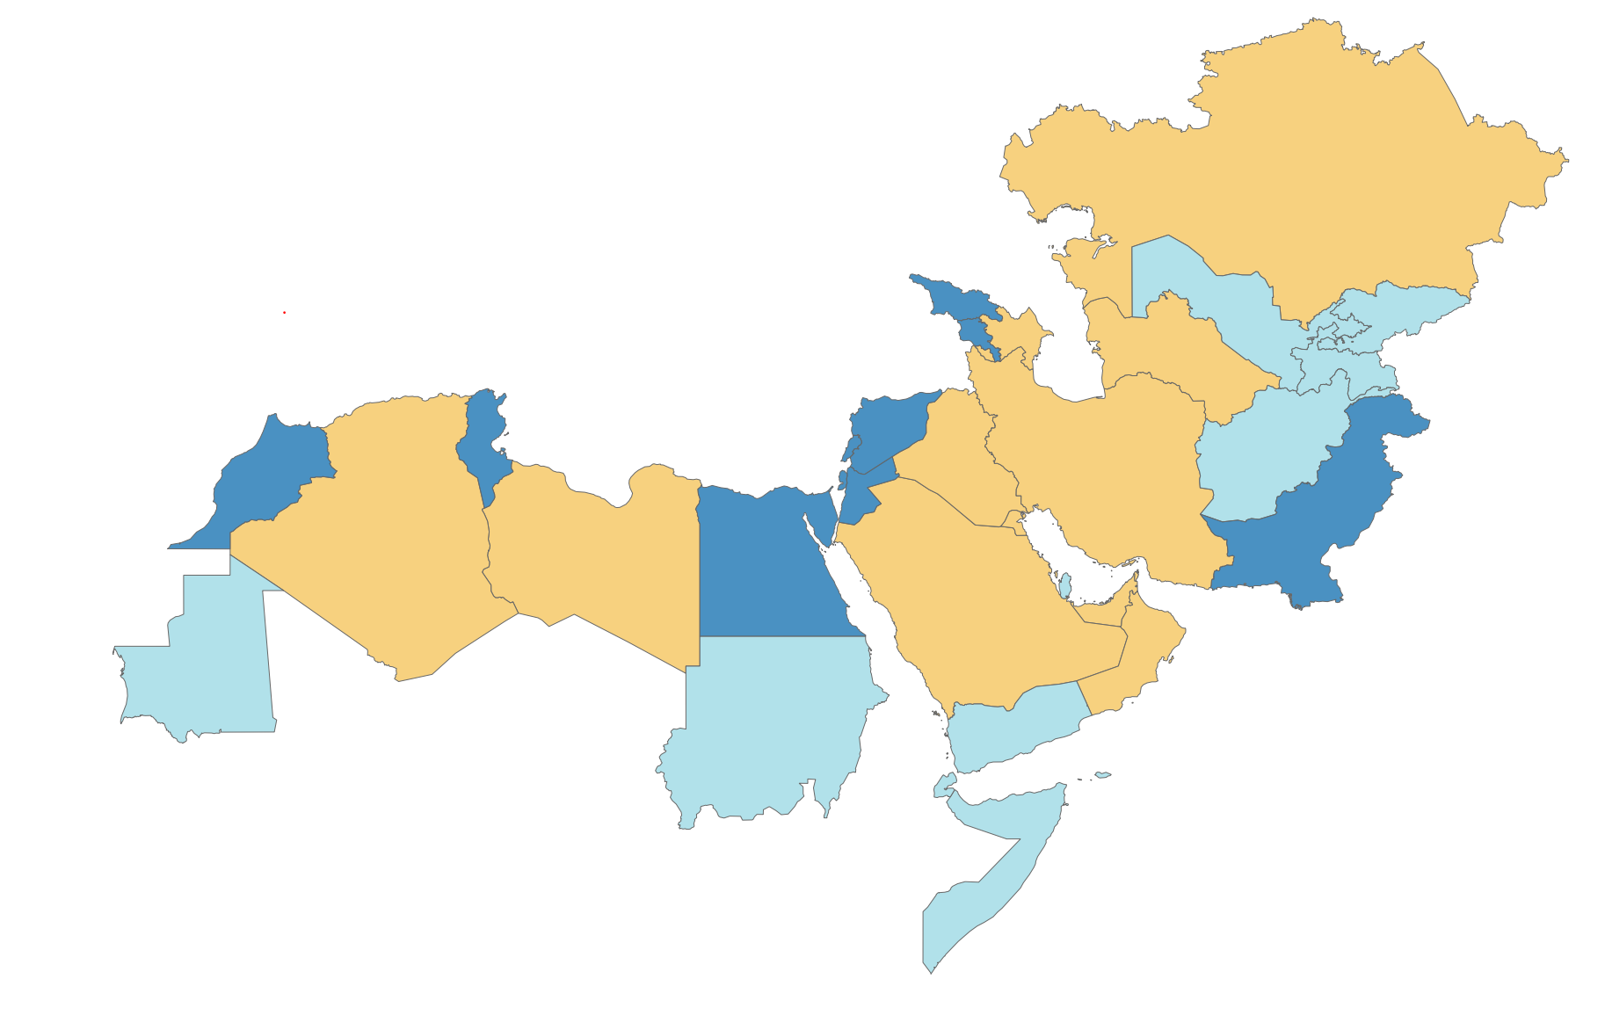
The balance of risks remains tilted to the downside and global financial stress is clouding the outlook
Slower growth in advanced economies due to global financial stress
Tighter for longer global financial conditions and debt distress risks
DOWNSIDE RISKS
More entrenched inflation expectations
Food security and increased social tensions
Intensification of regional conflicts
Deepening geo-economic fragmentation
Climate-change related risks
UPSIDE RISKS

Slide 12
Elevated debt and financing needs will weigh on MENAP EMs' prospects
Elevated debt will require ambitious consolidation amid high social needs …
… and high external net placements of sovereign bonds
Strong bank-sovereign nexus increases macro-financial stability risks
MENA EM&MI and PAK: Debt and Consolidation Path
(Percent of Fiscal Revenues and GDP, respectively)
MENA EM&MI and PAK: Maturing Debt and External Market Debt Issuance
(Billions of USD)
Banking system exposure to the sovereign: Bank holdings of government debt
(Percent of banking system assets)
Sources: IMF, World Economic Outlook database; and IMF staff calculations. Consolidation is defined as cumulative changes in the primary balance as a share of GDP.
Sources: Bloomberg L.P.; IMF, World Economic Outlook database; and IMF staff calculations.
Sources: Integrated Monetary database; and IMF staff calculations.
Note: The sovereign includes general government and state-owned enterprises.

Slide 13
Policy Priorities

Slide 14
Multipronged reform agenda will help strengthen resilience and inclusion and mitigate growing fragmentation risks
RESTORE PRICE STABILITY AND PRESERVE FINANCIAL STABILITY
MAINTAIN A TIGHT FISCAL STANCE WHILE PROTECTING THE VULNERABLE
STRUCTURAL POLICIES TO MAXIMIZE POTENTIAL GROWTH
Tighter monetary policy for countries with loose stance and inflationary pressures
Oil exporters should continue avoiding pro-cyclical policies and improve budget transparency
Bolstering private sector development
Do not loosen prematurely where stance is neutral or tight, and inflation has peaked
For EM&MIs, fiscal consolidation to preserve debt sustainability and improve fiscal institutions
Adjusting trade policy to improve resilience
Ensure adequate stress testing frameworks are in place and closely monitor financial sector vulnerabilities
LICs/FCS should seek grants and concessional financing to mitigate risks of debt distress and food insecurity
Ramp up diversification and de-carbonization while ensuring energy security

Slide 15
Thank you

