Slide 1
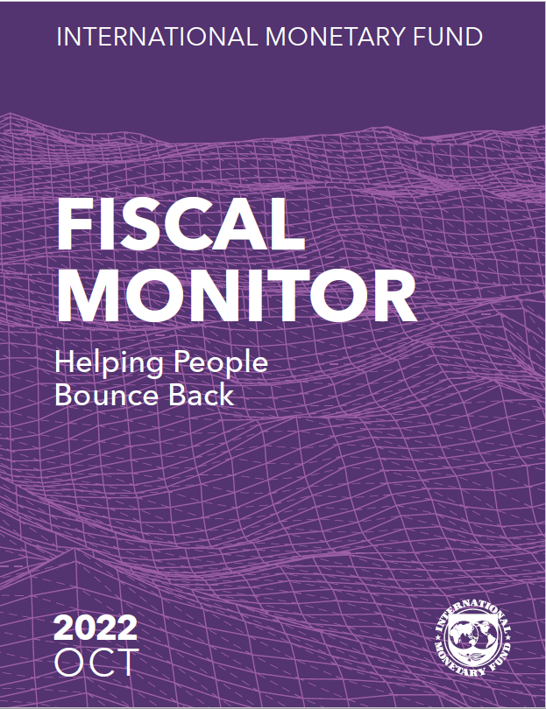

Presentation of IMF
Fiscal Monitor
IMF Middle East Center for Economics and Finance (IMF-CEF)
Institute of Capacity Development
February 2023
Raphael Lam and Roberto Piazza
Fiscal Affairs Department

Slide 2
Overview
Recent macro-fiscal developments and outlook.
Early lessons of the pandemic on fiscal policies.
Return to fiscal rules and fiscal framework?
Fostering economic resilience of people against large job and income losses.
Main question: How can fiscal policy navigate policy trade-offs and prepare in a shock-prone world?

Slide 3
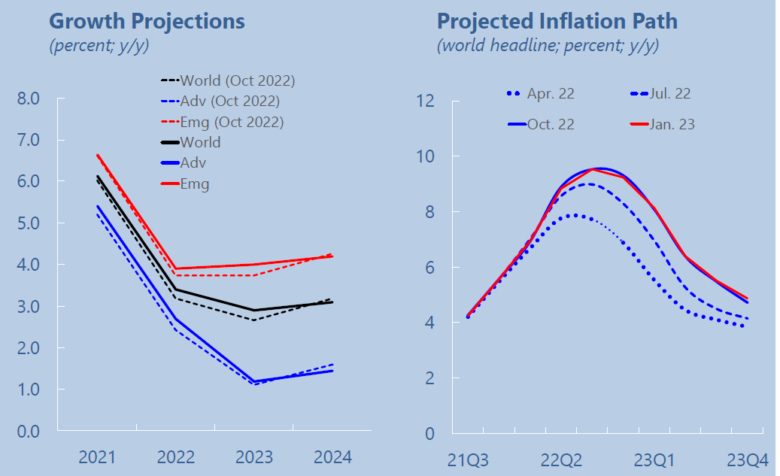
Global Growth is Bottoming Out and Inflation Peaking
IMF January 2023 World Economic Outlook Update.
Notes:
In response to COVID-19, governments provided sizable fiscal support and relaxed fiscal rules.
Countries now face record debt levels, amidst tightening financial conditions and rising fiscal sustainability concerns.
New shocks (energy crisis, global security) and emerging long-term trends (climate change, demographics) add to the challenge.
The main question now is how to design a medium-term fiscal framework (MTFF) that provides credible forward guidance to navigate policy trade-offs?

Slide 4
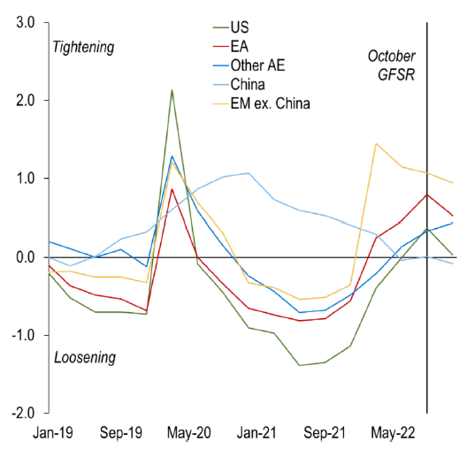
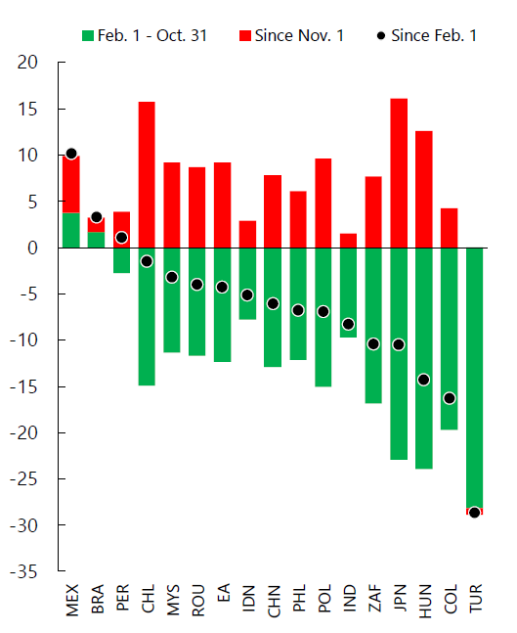
Global Financial Conditions Have Eased in Recent Months
Financial Conditions: Advanced Economies
(Standard Deviations From The Mean)
Exchange Rate with U.S. Dollar
(Percent change; as of Jan 2023)
Source: IMF Global Financial Stability Report; National Sources; Bloomberg; Haver Analytics; Bank for International Settlements (BIS) Statistics & IMF Staff Calculations
Note: GFSR refers to the IMF Global Financial Stability Report
.
Notes:
In response to COVID-19, governments provided sizable fiscal support and relaxed fiscal rules.
Countries now face record debt levels, amidst tightening financial conditions and rising fiscal sustainability concerns.
New shocks (energy crisis, global security) and emerging long-term trends (climate change, demographics) add to the challenge.
The main question now is how to design a medium-term fiscal framework (MTFF) that provides credible forward guidance to navigate policy trade-offs?

Slide 5
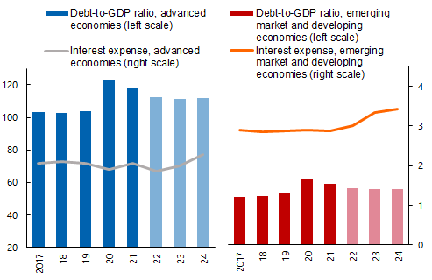
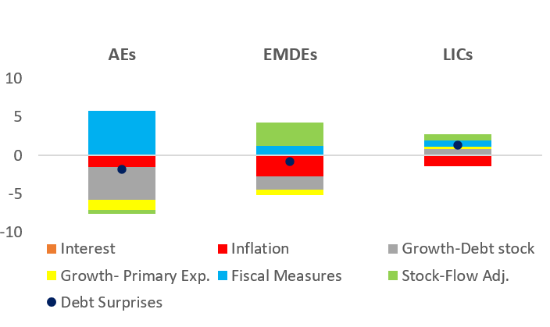
Elevated Debt Levels and Interest Payments amid High Inflation
Surge in Global Debt Burden
(Percent of global GDP)
Drivers of Debt Surprises in 2021
(Percent of GDP)
IMF October 2022 World Economic Outlook.
World Economic Outlook and IMF staff calculations.
Notes:
In response to COVID-19, governments provided sizable fiscal support and relaxed fiscal rules.
Countries now face record debt levels, amidst tightening financial conditions and rising fiscal sustainability concerns.
New shocks (energy crisis, global security) and emerging long-term trends (climate change, demographics) add to the challenge.
The main question now is how to design a medium-term fiscal framework (MTFF) that provides credible forward guidance to navigate policy trade-offs?

Slide 6
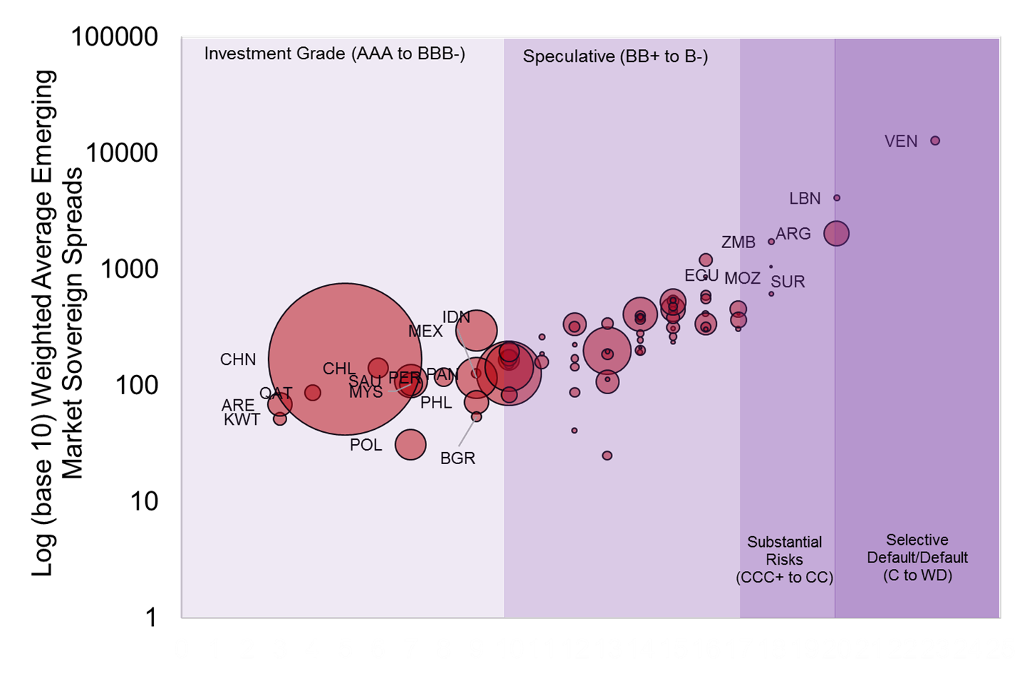
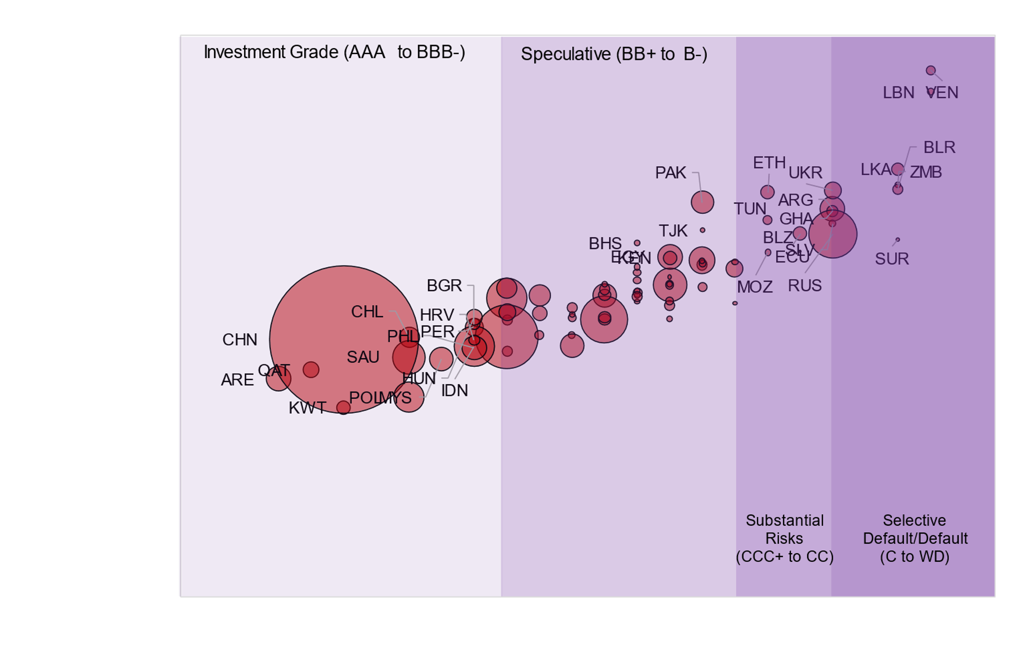
Debt Vulnerabilities Remain High
Comparison of Debt Vulnerabilities:
EMDEs Spreads & Ratings (Pre-Pandemic and Current)
Pre-Pandemic
(Feb 21, 2020)
Current
(Oct 18, 2022)
Source: JP Morgan EMBI Sovereign Spreads, Bloomberg Finance, Moody’s Ratings, S&P Sovereign Ratings, Fitch Ratings & IMF Staff analysis
Note: The figures use the JP Morgan EMBI Sovereign Spreads and supplements with the MCM dataset prepared using Bloomberg. Coverage for the Spreads and Ratings figures span across 63 EMEs and 16 LIDCs. The figures use the Log (base 10) scale on the vertical axis, representing weighted average sovereign spreads on Eurobonds. Bubble sizes represent the country's gross domestic product, in USD, current prices. Labels are only shown for Investment Grade, Substantial Risks or Selective Default/Default categories or countries with spreads over a 1000 bp (in Distress). The credit ratings are the lowest end of month credit ratings on the previous month across all three major credit agencies (S&P, Moody’s & Fitch). The Ratings classification are standardized to the Fitch Rating hierarchy nomenclature. The figure here includes 79 EMDEs of which: 12 are low-credit risk (15% of sample, 55% of the EMDEs GDP); 37 are performing (47% of sample, 25% of the EMDEs sample GDP); 9 are stressed (11% of sample, 2% of the EMDEs GDP) and 21 are distressed (27% of sample, 10% of the EMDEs sample GDP). In cumulative, 30 EMDEs (38% of sample, 12% of the EMDEs GDP) are considered stressed or distressed. The figure uses the JP Morgan EMBIG Sovereign index for classification to allow for the inclusion of India and Venezuela.
Notes:
In response to COVID-19, governments provided sizable fiscal support and relaxed fiscal rules.
Countries now face record debt levels, amidst tightening financial conditions and rising fiscal sustainability concerns.
New shocks (energy crisis, global security) and emerging long-term trends (climate change, demographics) add to the challenge.
The main question now is how to design a medium-term fiscal framework (MTFF) that provides credible forward guidance to navigate policy trade-offs?

Slide 7
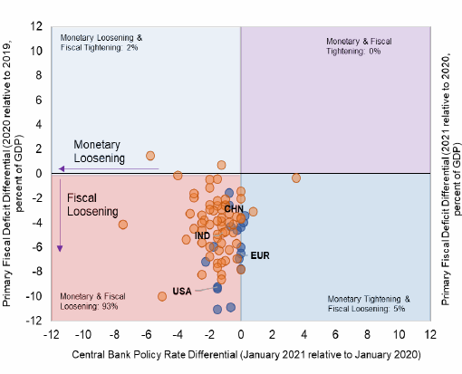
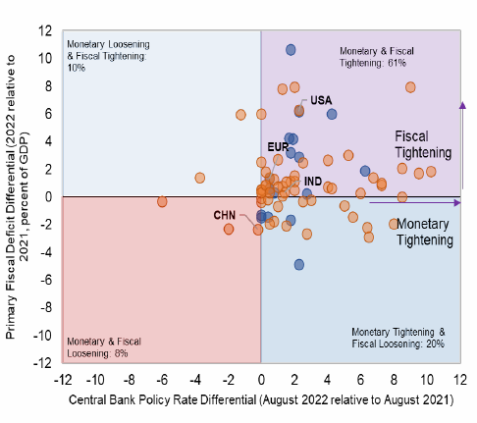
Shifting Macro Environments and Challenges after the Pandemic
Fiscal and Monetary Policies Interactions
2020
2022 (Projected)
IMF July 2022 World Economic Outlook. Median across countries for each income group.
IMF October 2022 World Economic Outlook.
Source: IMF Fiscal Monitor (October 2022); National Sources/ Haver Analytics
Note: Countries in blue represent Advanced Economies and orange represent Emerging Market & Developing Economies (EMDEs). The Euro Area is shown as a singular entity. Around 60% of the Sample is Tightening Monetary and Fiscal Conditions.
Notes:
In response to COVID-19, governments provided sizable fiscal support and relaxed fiscal rules.
Countries now face record debt levels, amidst tightening financial conditions and rising fiscal sustainability concerns.
New shocks (energy crisis, global security) and emerging long-term trends (climate change, demographics) add to the challenge.
The main question now is how to design a medium-term fiscal framework (MTFF) that provides credible forward guidance to navigate policy trade-offs?

Slide 8
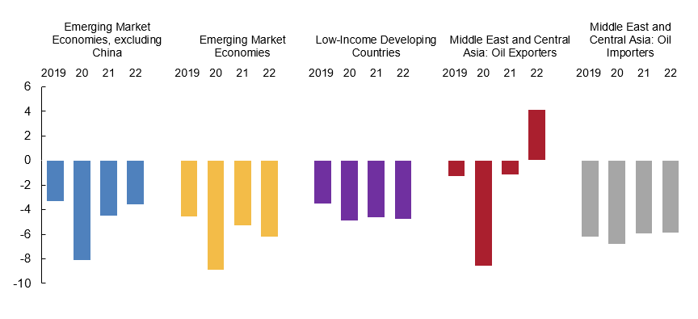
National Budget Balances in Middle East, North Africa, and Central Asia
National Budget Balances, by Income Group, 2019–22
(Percent of GDP)
Source: IMF World Economic Outlook (October 2022) & IMF Staff Calculations
Notes:
Replace red bar with MCS oil exporting and the grey bar with non oil exporting (the other bars stay the same)

Slide 9
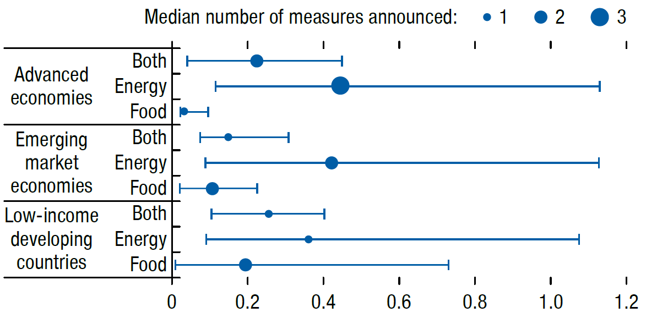
Energy and Food Crisis Put Pressure on Budgets for Oil Importers
Energy and Food Support Policies, by Income Group
(Percent of GDP, median, 20th and 80th percentiles)
Source: IMF Fiscal Monitor (October 2022); IMF staff estimates.
Note: Whiskers reflect the 20th and 80th percentiles. Dots reflect the median and the number of announced measures of each type.
9

Slide 10
Early Lessons from the Pandemic

Slide 11
Fiscal Policy can be Swift and Impactful
The degree of counter-cyclical fiscal policy tends to be larger during large adverse shocks.
Past experience shows that fiscal policy can be impactful and quickly implemented, particularly when monetary policy is constrained.
Degree of counter-cyclicality of fiscal policies
(Estimated coefficients)
Estimated based on a panel regression of change in overall balance on real growth and other control variables over 170 countries during 1990-2021.

Slide 12
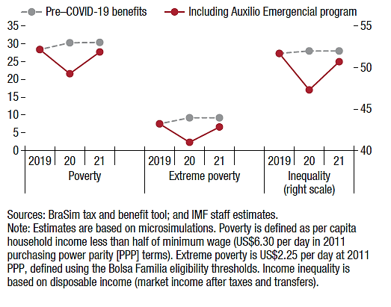
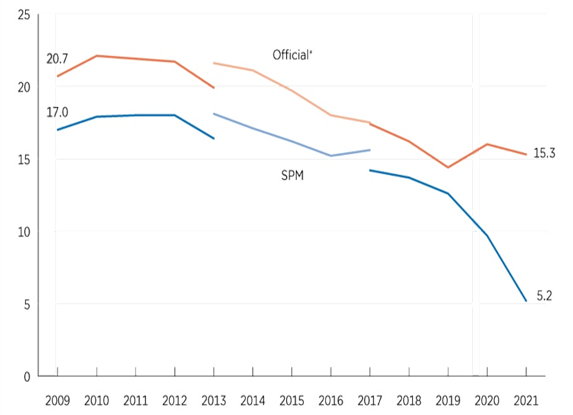
Fiscal Support During the Pandemic Helped Reduce Income Inequality and Extreme Poverty
Evolution of Poverty and Income Inequality during the Pandemic in Brazil, 2019−21
(Percent, left scale; Gini coefficients, right scale)
Child Poverty Rates Using The Official and The Supplemental Poverty Measures in the United States (2008-2021)
Source: IMF Fiscal Monitor (October 2022); BraSim tax and benefit tool and IMF staff estimates.
Note: Estimates are based on microsimulations. Poverty is defined as per capita household income less than half of minimum wage (US$6.30 per day in 2011 purchasing power parity [PPP] terms). Extreme poverty is US$2.25 per day at 2011 PPP, defined using the Bolsa Familia eligibility thresholds. Income inequality is based on disposable income (market income after taxes and transfers).
Sources: US Census Bureau; Current Population Survey, 2010 to 2022 Annual Social and Economic Supplements (CPS, ASEC)
Note: Population as of March of the following year. Official includes unrelated individuals under age 15. The Supplemental Poverty Measure (SPM) estimates for 2019 and beyond reflect the implementation of revised SPM methodology. More information is available in the report, Poverty in the United States: 2021. The data for 2017 and beyond reflect the implementation of an updated processing system. The data for 2013 and beyond reflect the implementation of the redesigned income questions. SPM extends the official poverty measure by taking account of many government programs that are designed to assist low-income families but are not included in the official poverty measure. The SPM also includes federal and state taxes and work and medical expenses. In addition, the SPM accounts for geographic variation in poverty thresholds, while the official poverty measure does not. The data points are placed at the midpoints of the respective years.
Notes:
The official is the red, the one with supplementary measures is the blue (the two lines go different direction swith covid)

Slide 13
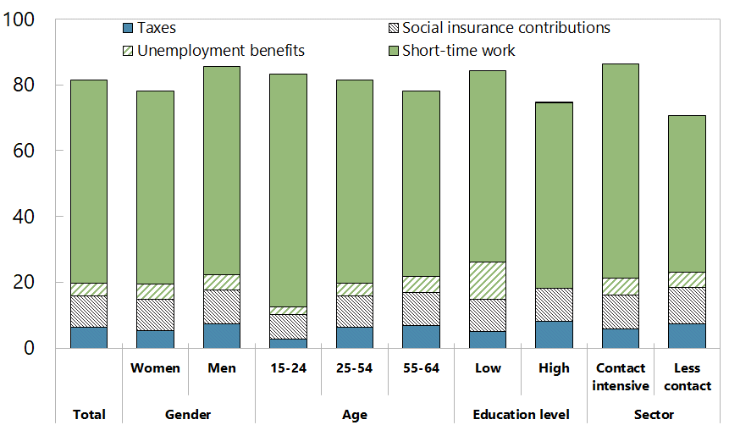
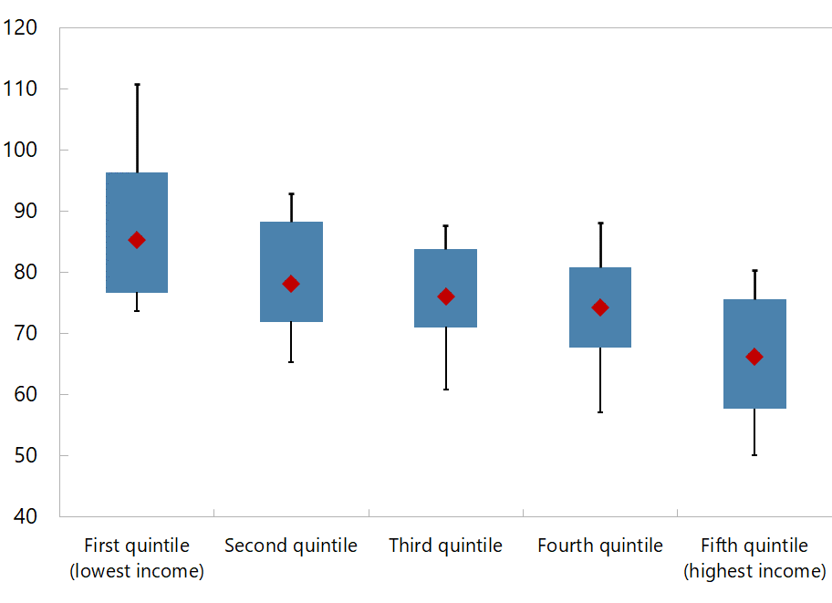
Job-retention schemes proved effective and well-targeted, making them a useful fiscal tool in face of a crisis.
Income Stabilization across EU Countries, by Household Income Groups
(Stabilization coefficients, percent)
EU: Income Stabilization by Worker Group and Sector
(Percent; share of the shock absorbed by the tax-benefit system)
Note: Estimates are based on the EUROMOD and microdata from the 2019 EU-SILC (excluding Germany). COVID shock is simulated to replicate the 2020 labor market conditions using Labor Market Adjustment (LMA) Add-On.
Source: Solovyeva et al. (forthcoming).
Notes:
The shock is the reduction in market income but the reduction is to the disposable income

Slide 14
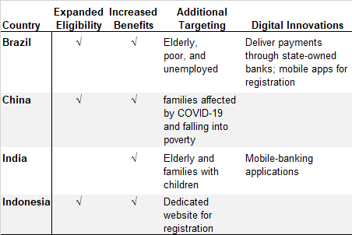
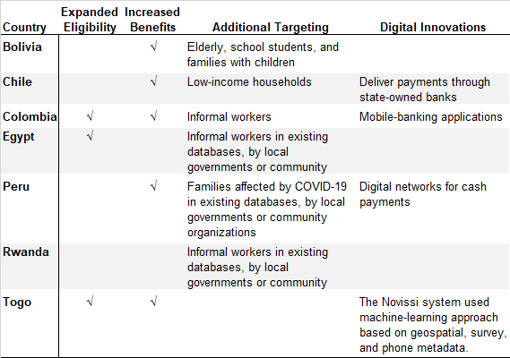
Leveraging Digital Technology in Social Support
Table. Examples of Additional Social Support during the Pandemic
(Selected Country Examples)
Emerging G20 Countries
Other Non G-20 Emerging Market and Developing Economies
Sources: IMF Fiscal Monitor (October 2022); Database of Fiscal Measures in Response to COVID-19 Pandemic; Shang, Evans, and An 2020; Una and others 2020.

Slide 15
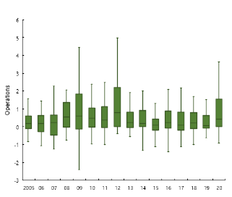
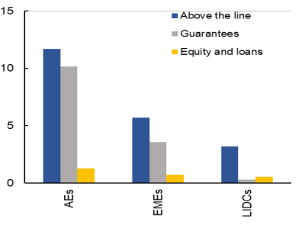
Support to Firms: Government as a Financier of Last Resort During Crises
Distribution of Net Loans and Equity Purchases
and Across Countries
(Percent of GDP)
Total announced measures in response to COVID-19
(Percent of GDP)
Source: Battersby et al. (2022), ‘The State as Financier of Last Resort’, IMF SDN No. 2022/003; IMF Government Financial Statistics for panel 1 (see footnote 3 in SDN for country coverage); and Eurostat for panel 2.
Note: Net loans and equity purchases by the general government when available; otherwise, central government. Coverage over 2007–20 varies.
Battersby et al. (2022), ‘The State as Financier of Last Resort’, IMF SDN No. 2022/003; Bankruptcy information from the OECD; and Euler Hermes Global Insolvency Report from Allianz Trade. Fiscal Support Measures from IMF Fiscal Monitor 2021
Notes:
Look at the SDN to see if there is better chart for the LHS

Slide 16
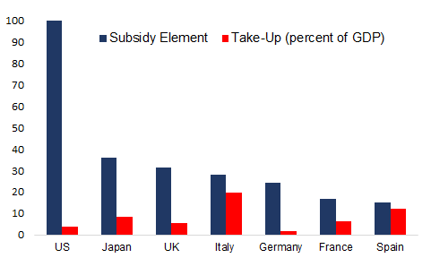
Managing fiscal risks for exceptional financing measures
Mounting risks of widespread bankruptcies during COVID-19: severe and evident negative externalities.
Feasibility of exceptional financing measures depends on policy space, institutional capacity, etc.
Design considerations:
  Assessing firms’ viability (involving private sector)
  Targeting and exit strategies to contain cost
  Choice of instruments differentiated by firm size and gov capacity
  Managing fiscal risks—novel fair-value method using market rates to estimate fiscal cost.
Estimated Total Subsidy Element and Take-Up
(Subsidy element: percent of loan principal, Take-up: percent of GDP)
Source: Hong and Lucas (forthcoming). Subsidy element is a weighted average of the subsidy elements calculated for different schemes introduced in each country. The US Paycheck Protection Program (shaded blue) is recorded as an above-the-line item, as the program is essentially fully subsidized. Data up to end 2021.
Notes:
Credit programs constitute fiscal risks and continued close monitoring of fiscal risks is warranted. In fact, most governments fail to recognize the full cost of credit assistance upfront in their budgetary accounts. The costs of credit support measures are not easy to quantify, relative to traditional fiscal expenditures like cash grants or tax reductions, due to contingent cash flows that expose the issuing government to significant but low-probability risks, often over an extended period. However, it is crucial to be able to make the costs of credit programs comparable to other above-the-line measures to ensure prudent use of fiscal policy.
In the Chapter, we employ a fair-value method to estimate the costs of guarantee programs for seven large advanced economies for credit guarantee programs during the pandemic. A fair-value method reflects the uncertain cash flows of corporate loans by using the market rate to calculate the present value of government guarantees, comparable to other (above-the-line) fiscal spending.
A subsidy element is measured as the difference between actual disbursement amount and the present value of all the expected future cash flows associated with the program. The average subsidy element of credit guarantee programs is about 38 percent (as a percent of loan principal), and there exists a wide variation across programs.
The subsidy element depends on the program design, with an increased maturity, guarantee coverages leading to an increase in subsidy element, while an increase in mandated rate lowers subsidy element.

Slide 17
Return to the Fiscal Rules?

Slide 18
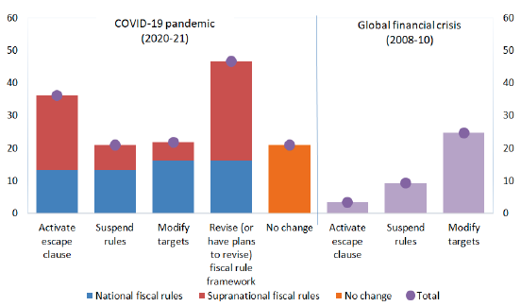
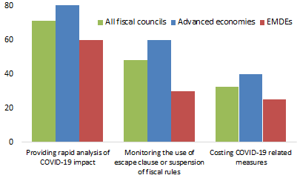
The COVID-19 pandemic put fiscal rules and frameworks to test.
Adjustments in Fiscal Rules during Crises
(Percent of countries with at least one fiscal rule)
Functions Performed by Fiscal Councils
(Share of total fiscal councils)
Davoodi and others (2022)
Davoodi and others (2022)
Notes:
Story for the right chart: fiscal council are important, even in covid crisis, for instance when they do costing

Slide 19
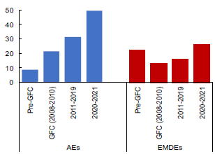
Aftermath of the Pandemic: A Return to Old Rules?
Deviations from Debt Rules
(Percent of GDP)
Deviations from Budget Balance Rules
(Percent of GDP)
Davoodi and others (2022); IMF Fiscal Rules Dataset.
Note: Only positive deviations are considered, referring to deficits or debt exceeding the fiscal rule limits or anchor levels.
Notes:
Nearly 80% of countries activated escape clauses, suspended, or modified fiscal rules during the pandemic, to create additional space for fiscal policy reaction.
Large deviations from fiscal rule debt and deficit limits makes a return to old rules unfeasible for many.

Slide 20
Main Takeaways
Increasingly fragile and shock-prone world raises the specter of more frequent and widespread fiscal crises.
The Fiscal Monitor discusses how fiscal policy contributes to a resilient society, in which people can bounce back from adversity. Important tradeoffs:
  Building fiscal buffers is key in fostering resilience—involving gradual fiscal adjustments in normal times.
  Interactions of fiscal policy and other macro-policies.
  Difficult spending prioritization: e.g., developing countries invest in development or spend on income stabilization programs?
The Fiscal Monitor recommends a comprehensive strategies within medium-term fiscal frameworks and scalable social protection system, but also building fiscal buffers and a return to fiscal rules.

Slide 21
Thank you

