Slide 1

How to Achieve Inclusive Growth
Middle east center for economics and finance
june 21, 2022
Valerie Cerra, Assistant Director, FAD, IMF
The views expressed are those of the presenter and do not necessarily represent those of the IMF or IMF policy.

Slide 2
Editors and Authors
  Editors: Valerie Cerra, Barry Eichengreen, Asmaa El-Ganainy, Martin Schindler
  Authors:
  Academic: Philippe Aghion, Thorsten Beck, Barry Eichengreen, Raquel Fernandez, Simon Johnson, Anton Korinek, Peter Montiel, Giovanni Peri, Richard Rogerson, Joseph Stiglitz, Sir Nicolas Stern, Tony Venables
  Brookings Institution: Amar Bhattacharya
  Commitment to Equity Institute: Nora Lustig, Jon Jellema
  European Bank for Reconstruction and Development: Zsoka Koczan, Barbara Rambousek
  International Labor Organization: Ekkehard Ernst, Rossana Merola
2

Slide 3
Authors (continued)
  World Bank: Benedicte Baduel, Deon Filmer, Roberta Gatti, Norman Loayza, Halsey Rogers
  World Trade Organization: Marc Bacchetta, Roberta Piermartini, Maarten Smeets
  IMF, Joint Vienna Institute, and Middle East Center for Economics and Finance: Khaled Abdelkader, Sriram Balasubramanian, Adolfo Barajas, Mohamed Belhaj, Sami Ben Naceur, Lahcen Bounader, Jana Bricco, Valerie Cerra, Reda Cherif, Balazs Csonto, Hamid Davoodi, Ruud de Mooij, Barbara Dutzler, Asmaa El-Ganainy, Drilona Emrullahu, Holger Floerkemeier, Fuad Hasanov, Asel Isakova, Maksym Ivanyna, Ruy Lama, Francesco Luna, Priscilla Muthoora, William Oman, Magali Pinat, Nathalie Pouokam, Dmitriy Rozhkov, Andrea Salerno, Martin Schindler, Nikola Spatafora, Anna Ter-Martirosyan, Mohamed Trabelsi, Dmitry Vasilyev, Younes Zouhar
3

Slide 4

Global Context

Slide 5
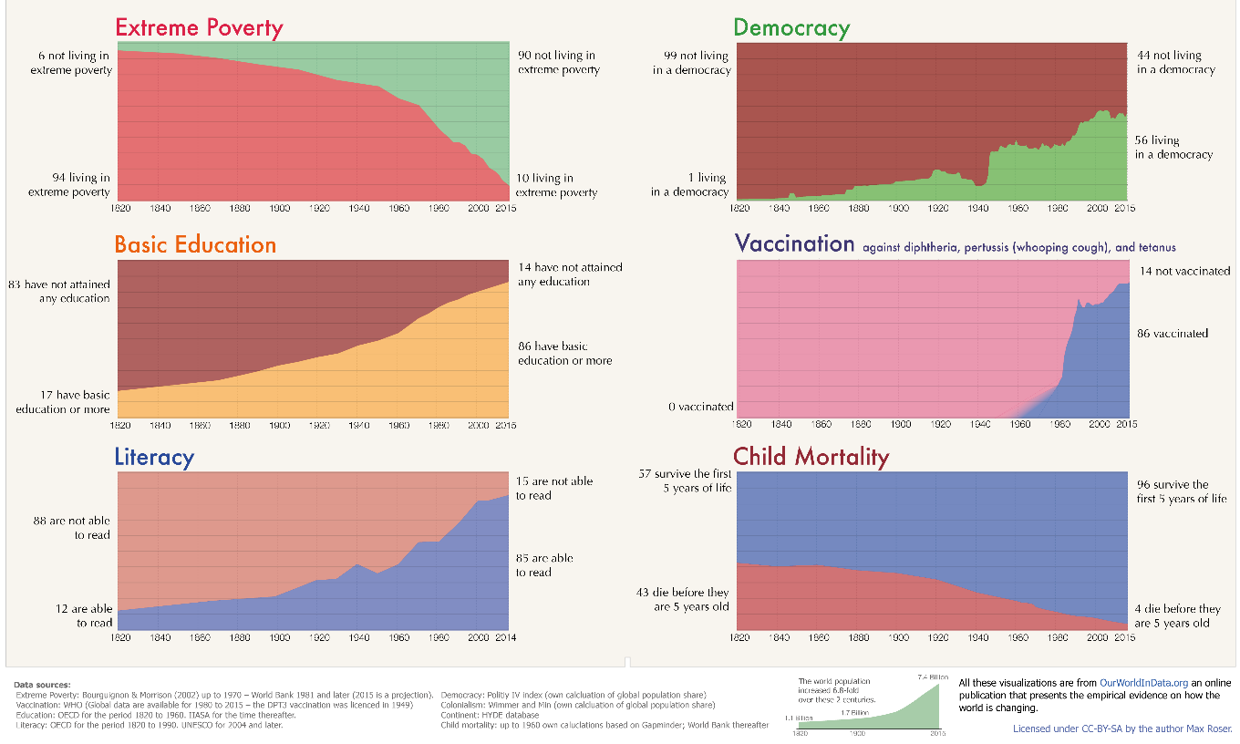
Two Centuries of Progress
Source: Cerra, Chapter 1 of How to Achieve Inclusive Growth; and Max Roser, OurWorldInData.org, https://ourworldindata.org/a-history-of-global-living-conditions-in-5-charts

Slide 6
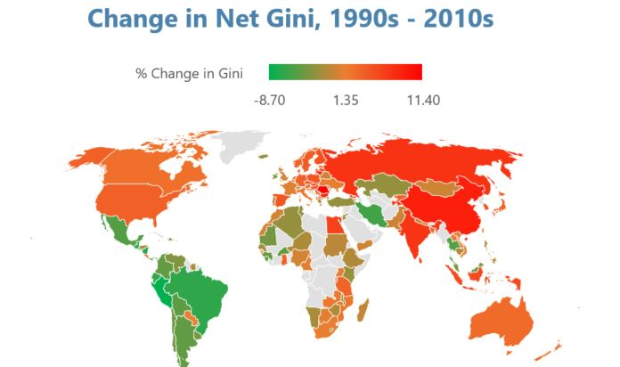
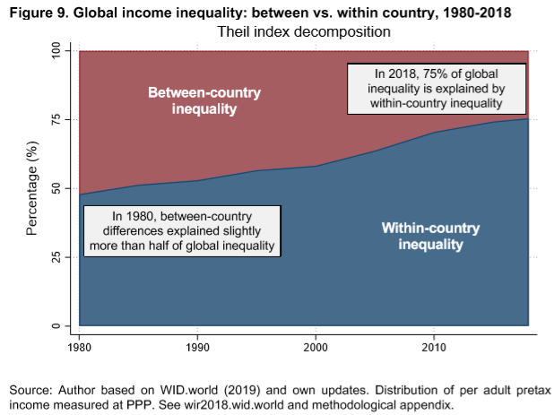
Rising Inequality Within Countries
Global Income Inequality: Between vs. Within Country, 1980-2018
Sources: Cerra, Chapter 1 of How to Achieve Inclusive Growth; SWIID; and Chancel, in World Inequality Report 2018. Note: LH chart: Gray stands for no data. RH chart: Distribution of per adult pretax income measured at PPP.

Slide 7
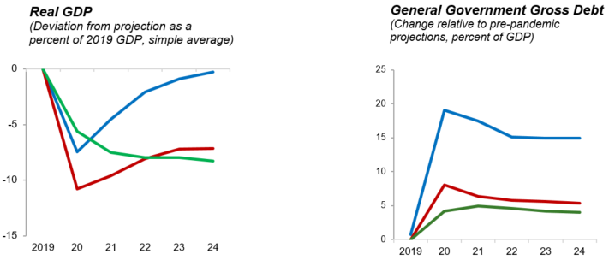

Effect of COVID-19 Pandemic on Forecasts of GDP and Public Debt
Sources: Fiscal Monitor and IMF World Economic Outlook database, October 2021; and staff estimates.

Slide 8
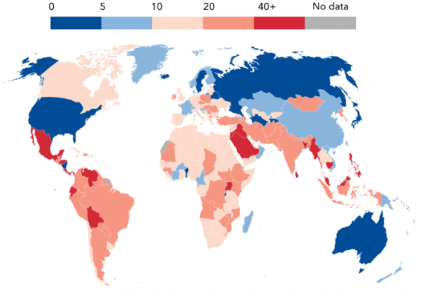
Pandemic Widens Employment and Educational Gaps
Labor Markets in EMDEs
(Average percent difference from 2019:Q4 to 2021:Q1)
School Closures
(Total duration of full school closures in weeks, 3/2020-10/2021)
Sources: IMF World Economic Outlook, October 2021; International Labor Organization; and IMF staff estimates.
Sources: Ruchir Agarwal, IMF blog Feb 3, 2022; UNESCO global dataset; and IMF staff estimates.

Slide 9
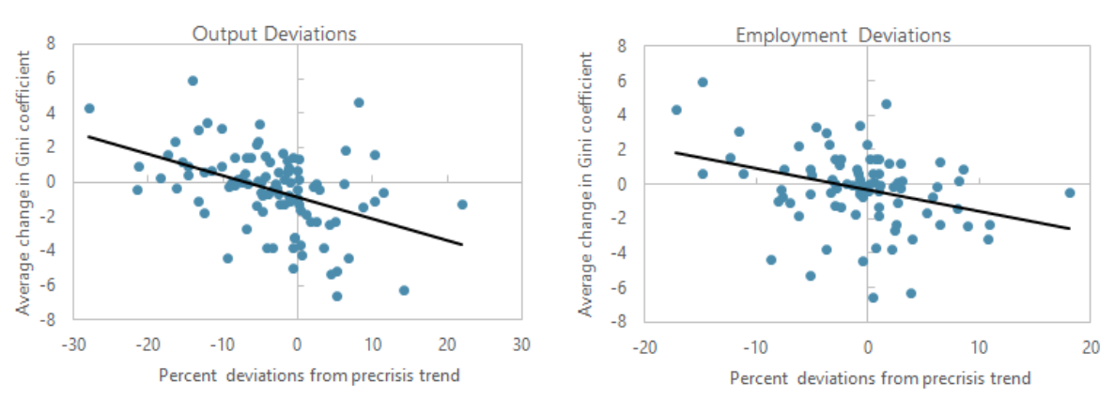
Output and Employment Scarring Lead to Higher Inequality
Source: Davoodi, Montiel, and Ter-Martirosyan, Chapter 11 of How to Achieve Inclusive Growth; WEO (2018); and Solt (2020).

Slide 10
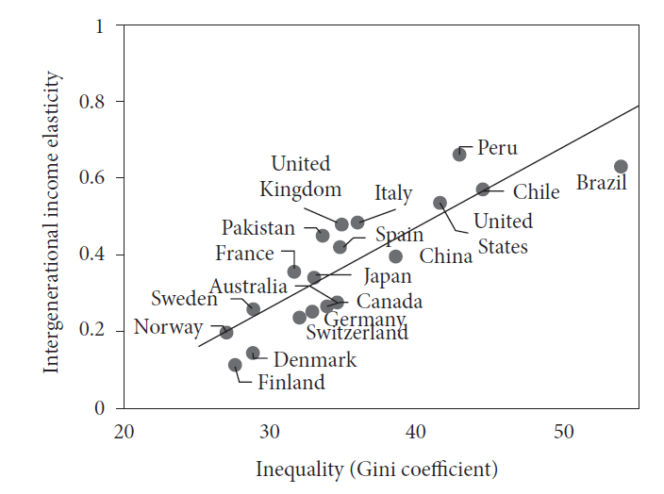
Inequality Exacerbates Poverty Traps and Social Immobility
Source: Baduel, Isakova, and Ter-Martirosyan, Chapter 18 of How to Achieve Inclusive Growth; World Bank, WDI and GDIM databases.

Slide 11
A Framework for Inclusive Growth and Sustainable Development

Slide 12
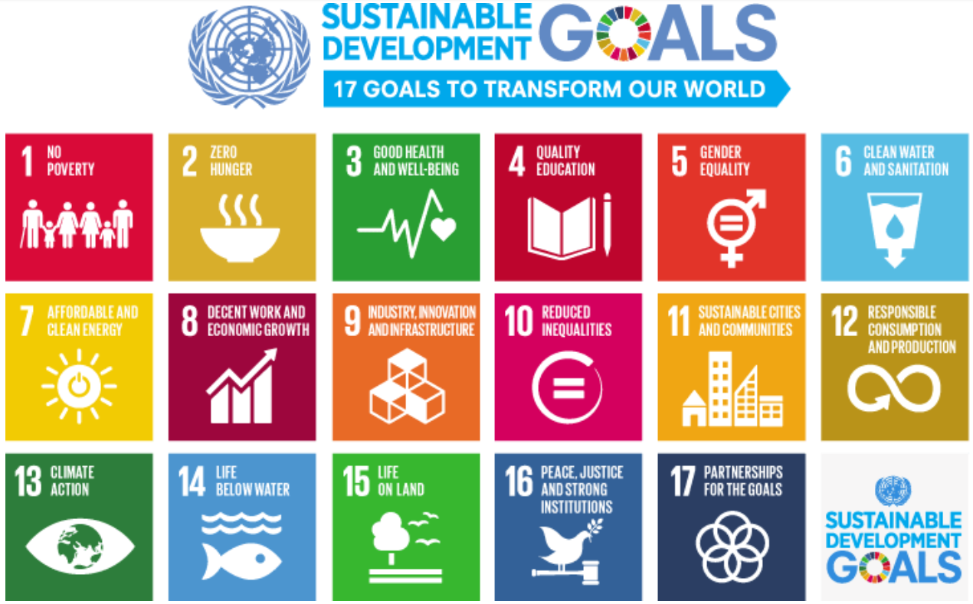

Slide 13


















Private
Inputs
Labor
Capital
Technology
Markets
Domestic
Outcomes
Global
Migration
Capital Flows
Trade
Gender
Regions
Pre-fiscal Outcomes
Post-fiscal Outcomes
Generations
Environment
Govt
Inputs
Governance
Politics
Macro-stability
Public services
Taxes & transfers

Slide 14
Private
Inputs
Labor
Capital
Technology
Markets
Domestic
Outcomes
Global
Migration
Capital Flows
Trade
Gender
Regions
Pre-fiscal Outcomes
Post-fiscal Outcomes
Generations
Environment
Govt
Inputs
Governance
Politics
Macro-stability
Public services
Taxes & transfers

Slide 15

Private
Inputs
Labor
Capital
Technology
Markets
Domestic
Outcomes
Global
Migration
Capital Flows
Trade
Gender
Regions
Pre-fiscal Outcomes
Post-fiscal Outcomes
Generations
Environment
Govt
Inputs
Governance
Politics
Macro-stability
Public services
Taxes & transfers
15

Slide 16
IG book chapter topics
Introduction
An inclusive growth framework
Links between growth, inequality, and poverty
Factor and product markets
Labor markets
Financial inclusion
AI and technology
Competitive markets
Globalization
Trade
Financial integration
Migration
Government policies
Governance
Macro stability and debt
Taxation
Public spending and transfers
Education and health
Political reform
Disparities of outcomes
Gender equity
Regional disparities
Generational equity
Sharing natural resource wealth
Climate change
Putting it together
Country case studies
Recap and next steps
16

Slide 17
Tradeoffs? Growth -> Poverty and inequality
Employment, business opportunities ↑
Inequality,
poverty ↓
Growth
Resources for redistribution ↑
Asymmetric growth in different sectors
Growth
Inequality ↑
Asymmetric growth in factor payments (capital, skills)
Source: Cerra, Lama, and Loayza, Chapter 2 of How to Achieve Inclusive Growth
Notes:
Unemployment is the major source of labor income inequality. Okun’s Law – relationship between output and employment

Slide 18
Tradeoffs? Inequality and Poverty → Growth
Mild inequality
Sign of meritocracy: Factors paid their MP
Growth ↑
Poverty traps,
underutilitzation of L
Inequality,
poverty
Crime ↑, health outcomes ↓
Growth ↓
Inefficient institutions, policies
Trust ↓,
collective action ↓,
social conflict!
Source: Cerra, Lama, and Loayza, Chapter 2 of How to Achieve Inclusive Growth
Notes:
Poverty hinders the ability to accumulate physical or human capital and to adopt new technologies
Poverty traps are generated by:
Market inefficiencies
Threshold effects (indivisibilities/fixed costs)
Credit rationing: informational asymmetries, moral hazard
Risk and lack of insurance: the poor tend not to undertake risky activities
Institutional failures
Civil Conflict
Corruption
Property rights enforcement

Slide 19
Fiscal Policy, Institutions, and Inclusive Growth

Slide 20
Redistributive Impact of Fiscal Policy
Redistributive Impact of Fiscal Policy
Advanced Economies
Advanced economies
Developing countries
Source: Youhar, Jellema, Lustig, and Trabelsi, Chapter 13 of How to Achieve Inclusive Growth; and IMF Fiscal Monitor.
20

Slide 21
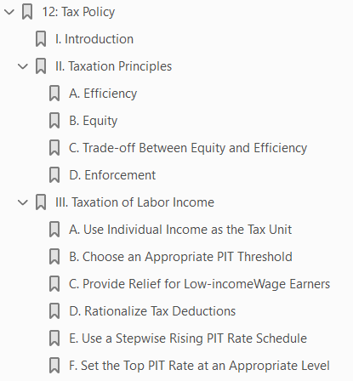
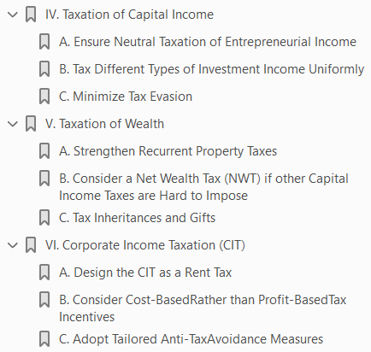
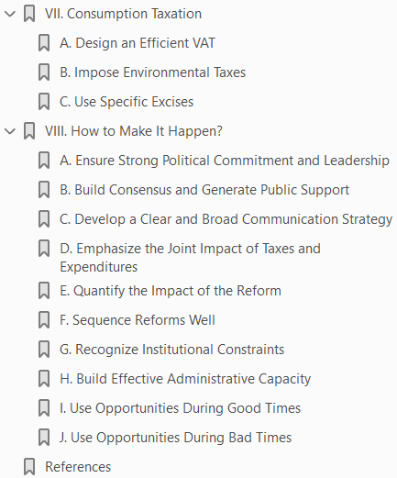
Tax Policy
Source: Abdelkader and de Mooij, Chapter 12 of How to Achieve Inclusive Growth.

Slide 22
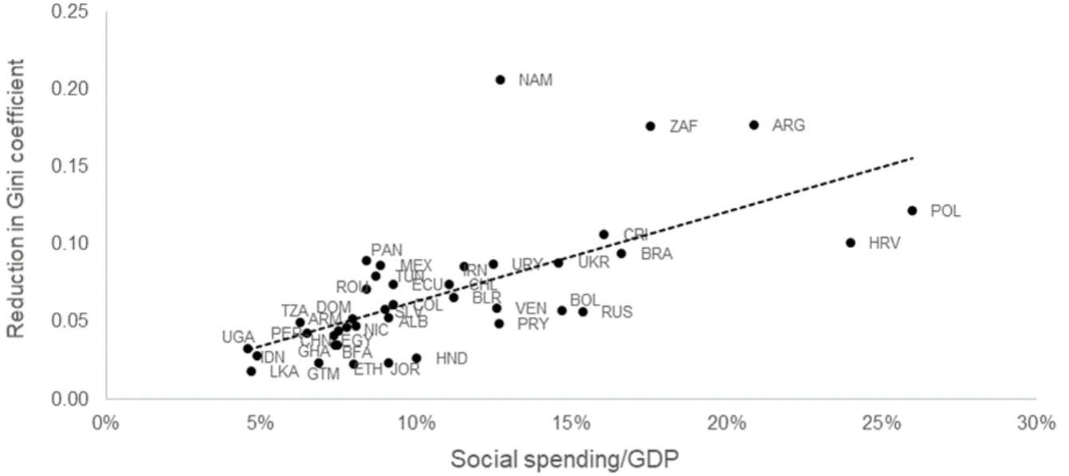
Fiscal Policy, Poverty, and Inequality
Inequality and Social Spending
Source: Youhar, Jellema, Lustig, and Trabelsi, Chapter 13 of How to Achieve Inclusive Growth; and IMF Fiscal Monitor.

Slide 23
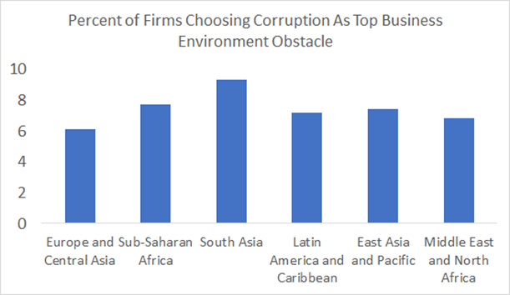
Corruption Alone Has Sizeable Macroeconomic Impact
  IMF, 2016: $1.5-2 trillion annually is paid in bribes
  TI Global Corruption Barometer 2017: 1 in 4 people pay bribes for public services
  Corruption is one of top obstacles to do business across the world:
Source: World Bank Enterprise Surveys, average over all surveys in 2009-2019
Source: Ivanyna and Salerno, Chapter 10 of How to Achieve Inclusive Growth; and IMF Fiscal Monitor.

Slide 24
Macro Volatility and Inclusive Growth

Slide 25
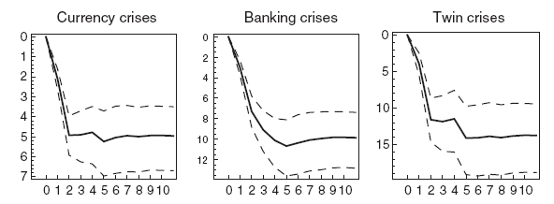
BOP and banking crises generate persistent output losses
Output relative to baseline
Cerra and Saxena, “Growth Dynamics: The Myth of Economic Recovery,” American Economic Review, March 2008

Slide 26
Macroeconomic Instability Leads to Divergence
Stylized Model of Development
Cerra and Saxena, IMF WP 17/250

Slide 27
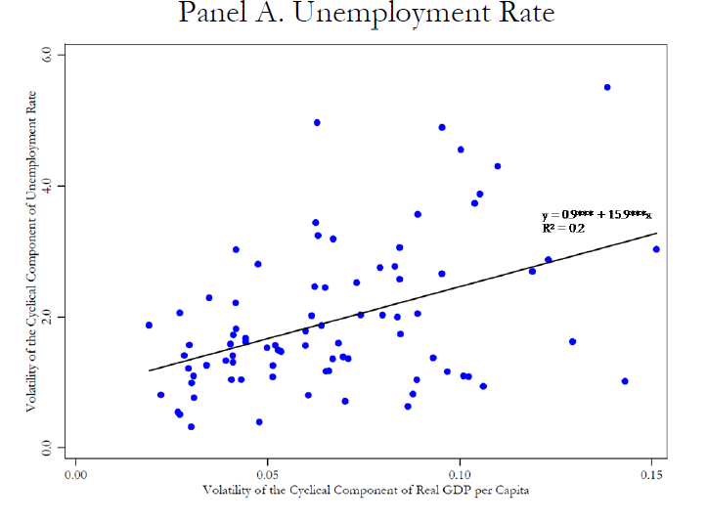
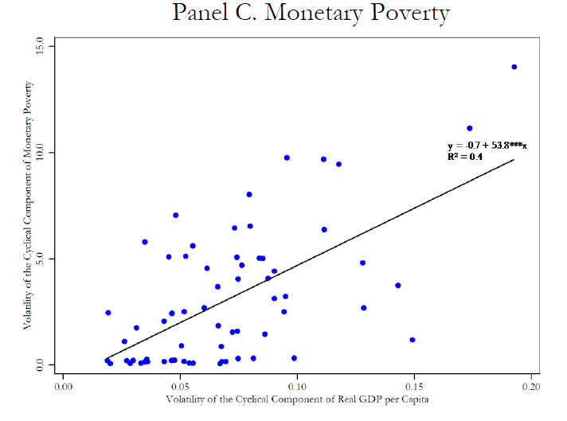
Poverty and unemployment: Highly sensitive to macro volatility
Poverty and unemployment: Highly sensitive to business cycles
(world sample)
Source: Camarena et al, 2019 “Fooled by the cycle: Permanent vs. cyclical improvements in social indicators” NBER WP
Source: Vegh et al, 2019 “Fooled by the cycle: Permanent vs. cyclical improvements in social indicators” NBER
27

Slide 28
Labor, Gender, Technology, and Finance

Slide 29
Lack of Labor Market Inclusiveness
Has Many Dimensions
Source: El-Ganainy, Ernst, Merola, Rogerson, and Schindler,Chapter 3 of How to Achieve Inclusive Growth.

Slide 30
Gender
  Legal Framework
  Eliminate discriminatory laws
  Civil rights (domestic violence, child marriage)
  Property rights (disjoint ownership and equal inheritance rights)
  Access to education
  Design laws to define digital worker’s rights
  Fiscal
  Review and amend tax code
  Eliminate discriminatory taxes
  Introduce Gender budgeting
  Set up gender-response expenditures
  Invest in child and elder care
  Incentives for women in STEM
  Invest in digital infrastructure accessibility for tele-work
  Labor Market
  Subscribe to ILO conventions
  Organize Active LP
  Retraining programs, especially after childbirth
  Financial and digital literacy
  Provide “long” paid and no transferable parental leave to fathers/male partners
  Education campaign
  Introduce quotas (political and corporate)
  Anti-discriminatory education: information campaigns against stereotypes. TV programs with educational and entertaining content against stereotypes
  Provide access to contraception and educate to its use
  Financial
  Provide incentives to banks to promote financial access for women
  Develop wireless payment systems
Source: Fernandez, Isakova, Luna, and Rambousek,Chapter 16 of How to Achieve Inclusive Growth.

Slide 31
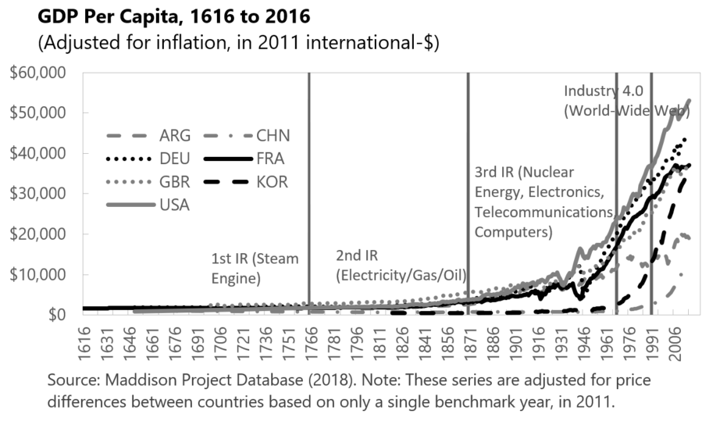
Advances in Technology Have Benefits and
Risks for Inclusion
Source: Korinek, Stiglitz, and Schindler,Chapter 5 of How to Achieve Inclusive Growth.

Slide 32
Financial Inclusion
  Functions of finance
  Frictions
    Asymmetric information
    Moral hazard
    Credit access
    Collateral constraints
    Inefficient intermediation
  Measures for HHs
    Simplify documentation
    Govt payments
    IT infrastructure for mobile money
    Financial literacy
  Measures for MSME
    Financial education for entrepreneurs
    Information – credit bureaus
    Collateral registries
Source: Barajas, Beck, Belhaj, and Ben Naceur, Chapter 4 of How to Achieve Inclusive Growth.

Slide 33
Globalization

Slide 34
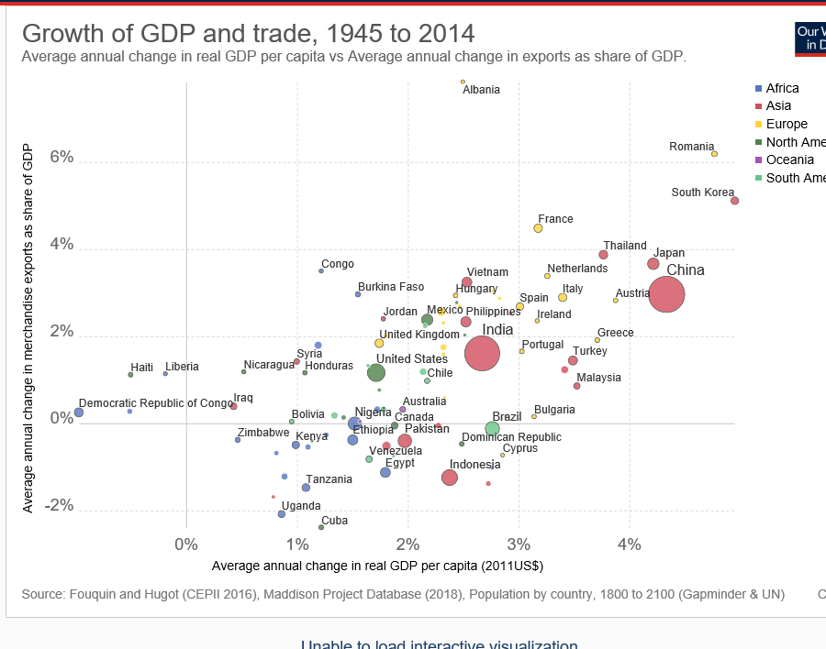
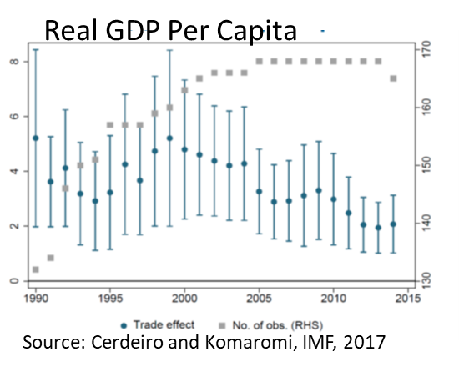
Trade openness is associated with higher growth
Source: Beaton et al, IMF 2017
Source: Bacchetta, Cerra, Piermartini, and Smeets, Chapter 7 of How to Achieve Inclusive Growth

Slide 35
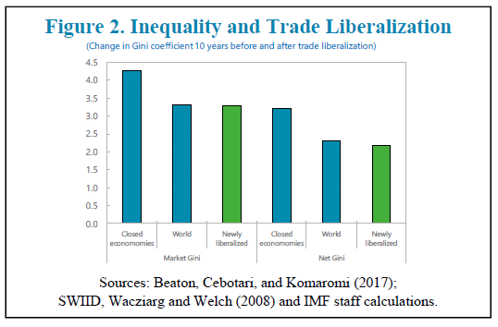
Trade slightly reduces inequality in the aggregate
Source: Cerdeiro and Komaromi, IMF, 2017
Source: Bacchetta, Cerra, Piermartini, and Smeets, Chapter 7 of How to Achieve Inclusive Growth

Slide 36
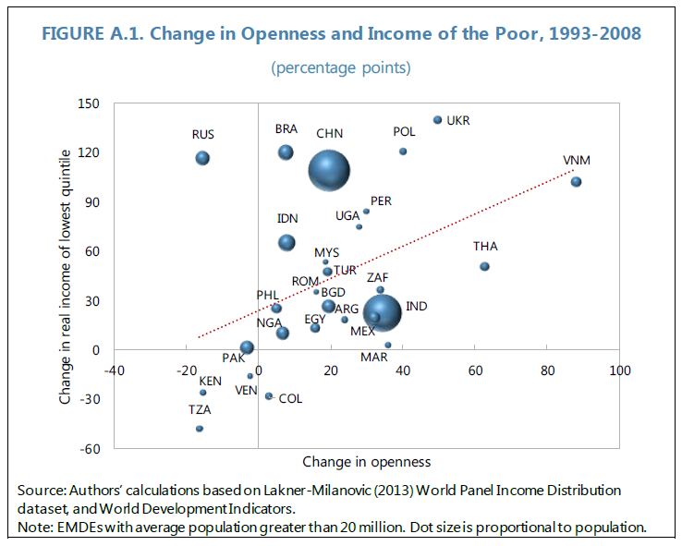
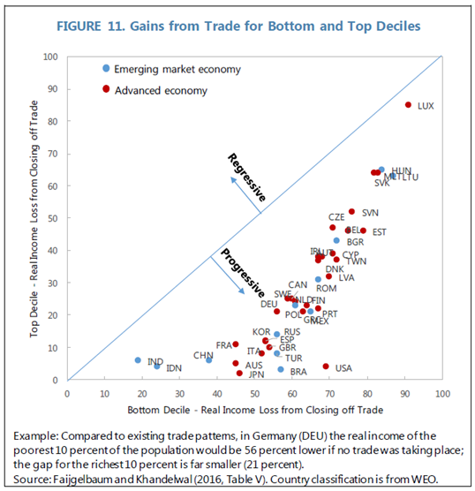
Trade provides gains for the poor
Source: Bacchetta, Cerra, Piermartini, and Smeets, Chapter 7 of How to Achieve Inclusive Growth

Slide 37
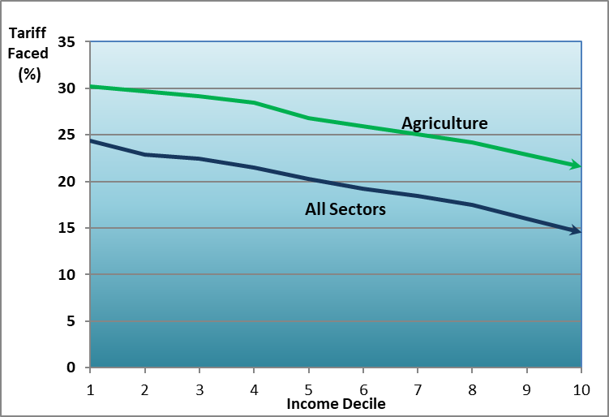
Tariff faced by income decile in agriculture and averaged across all sectors (India)
B
Source: Bacchetta, Cerra, Piermartini, and Smeets, Chapter 7 of How to Achieve Inclusive Growth

Slide 38
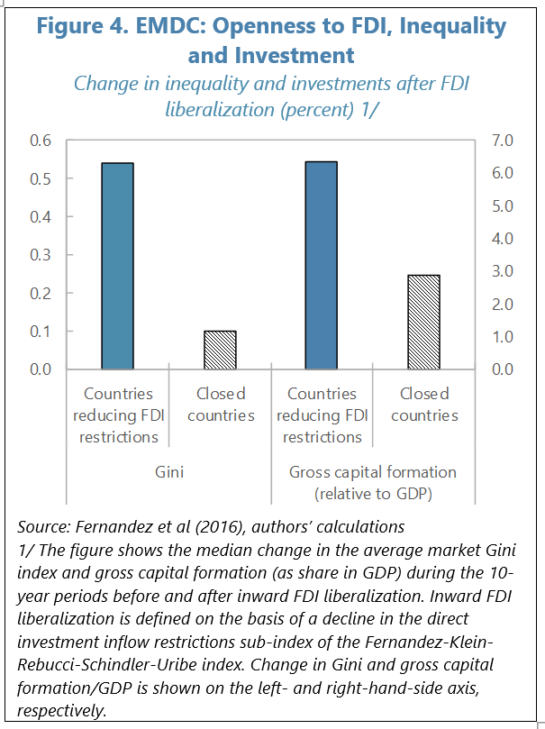
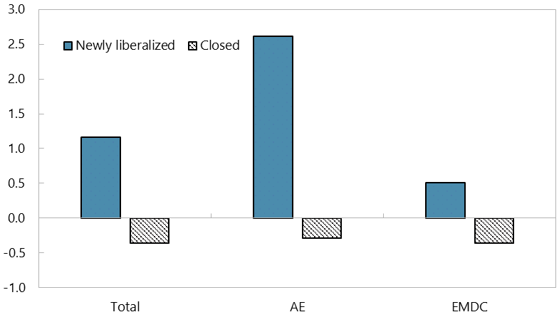
Financial Globalization and Inequality
Figure 3. Financial Globalization and Inequality
(Change in Gini Index after Capital Account Liberalization, percent)
Sources: Chinn-Ito (2006), SWIID, Lane and Milesi-Ferretti (2018), and authors’ calculations.
Notes: The figure shows the median change in the average market Gini index during the 10-year periods before and after capital account liberalization. Newly liberalized countries correspond to those liberalizing their capital account according to the methodology described in Figure 1. Closed countries are those with Chinn-Ito Index that is below the lowest value of the index at the time of capital account liberalization across episodes and those that do not liberalize their capital account over the following 10 years.
Source: Eichengreen, Csonto, and El-Ganainy, Chapter 8 of How to Achieve Inclusive Growth

Slide 39
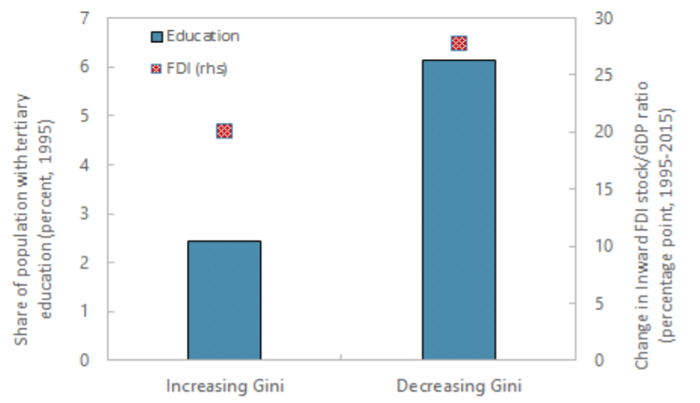
Financial Globalization, Education, and Inequality
Source: Eichengreen, Csonto, and El-Ganainy, Chapter 8 of How to Achieve Inclusive Growth

Slide 40
Migration
  Impact on migrants
  Impact on destination country
  Impact on origin country
    Brain drain
    Remittances
    Diaspora leading to investment, trade, and technology transfers
Source: Koczan, Peri, Pinat, and Rozhkov, Chapter 9 of How to Achieve Inclusive Growth

Slide 41
Climate Change

Slide 42
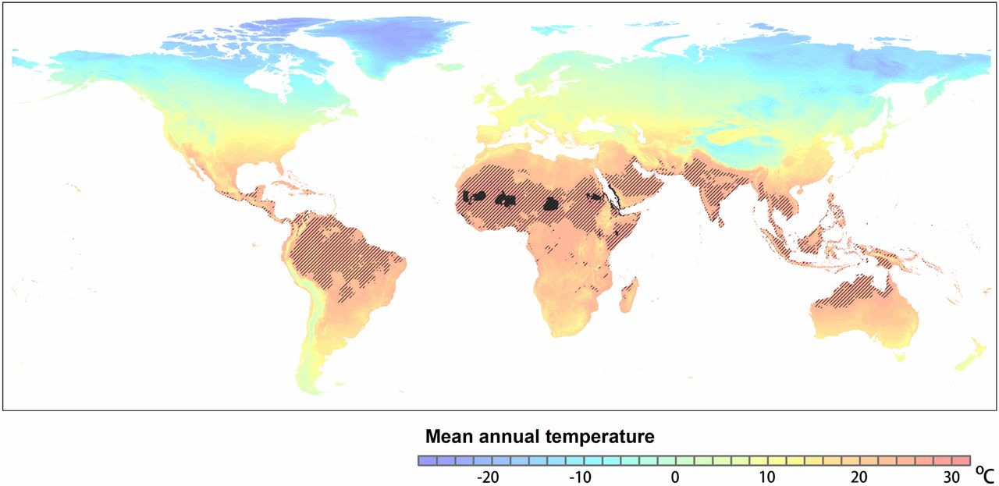
Business-As-Usual Cannot Continue:
Climate Action As Insurance Against Catastrophic Risks
BAU: Billions living in areas hotter than 29°C by 2070
Source: reprinted from (Xu, Kohler, Lenton, Svenning, & Scheffler, 2020). Small dark areas are those with mean average temperature (MAT) of over 29°C at present climate. Shaded areas are those with expected MAT of over 29°C by 2070 under RCP8.5 scenario. Background colors represent current MATs.
Source: Bhattacharya, Ivanyna, Oman, and Stern, Chapter 20 of How to Achieve Inclusive Growth
42
Notes:
Floods and storms are the most frequent. Storms affect Caribbean, US, Asia most, less important for SSA. Floods happen everywhere. Droughts are more prevalent in SSA.

Slide 43
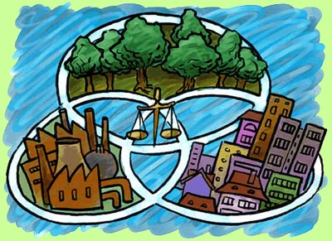
Climate Action: Unlocking Inclusive Growth Story of the 21st Century
Sustainability and environmental co-benefits
Lower inequality; decent living standards for all
Development needs
Major structural transformation in key economic systems:
Clean energy systems
Smarter urban development
Sustainable land use
Wise water management
Circular economy
Source: Bhattacharya, Ivanyna, Oman, and Stern, Chapter 20 of How to Achieve Inclusive Growth
43
Notes:
Energy supply in SSA in 2018 by source: total 820 mtoe (million tons of oil equivalents); coal – 111; natural gas - 116; oil – 186; biofuels waste – 363; hydro – 11.3; wind/solar – 6.8. Renewables change in time: 2.3 GWh in 2010 -> 22 GWh in 2018. But coal grows too, about 0.5% per year vs. 20% decline over 8 years in EU

Slide 44
Broad Policy Package to Enable the Transition
Broad Policy Package to Enable the Transition
Smooth the impact of climate shocks, ensure just transition
General enabling policies
Eliminate fossil-fuel subsidies, price carbon
Incentivize sustainable use of natural resources
Accelerate investment in sustainable and resilient infrastructure
Provide information and nudges to steer norms and behavior
Possible to grow prosperity and protect nature at the same time
Large overlap between mitigation and adaptation policies
Large scope to boost both inclusion and sustainability
Source: Bhattacharya, Ivanyna, Oman, and Stern, Chapter 20 of How to Achieve Inclusive Growth
44

Slide 45
Other Issues

Slide 46
Regional Disparities
  Regional Disparities
    Spatially Blind
    Spatially Connective
    Spatially Targeted
Source: Floerkemeier, Spatafora, and Venables, Chapter 17

Slide 47
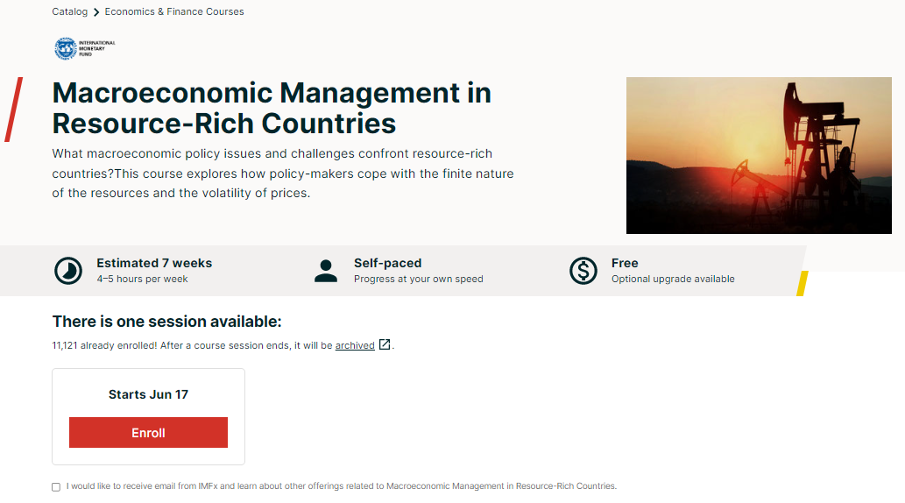
Managing Natural Resource Wealth
  Resource curse
  Conflict and fragility
  Governance
  Diversification
  Fiscal policy frameworks
    https://www.edx.org/course/macroeconomic-management-in-resource-rich-countrie
Source: Pouokam, Chapter 19 of How to Achieve Inclusive Growth

Slide 48
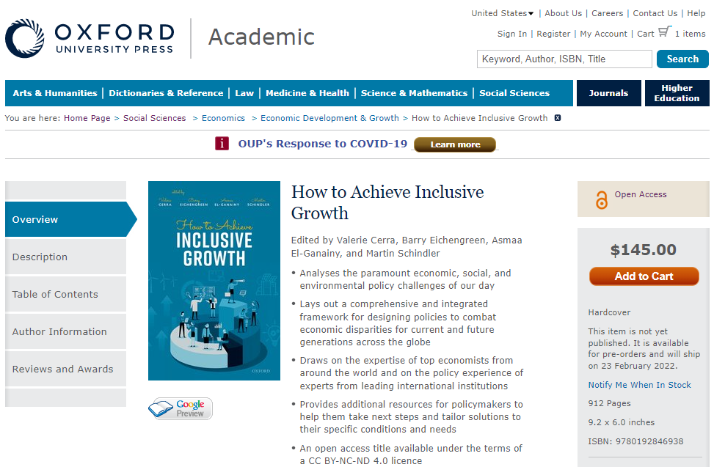

Link to Book
https://global.oup.com/academic/product/how-to-achieve-inclusive-growth-9780192846938?cc=us&lang=en&

Slide 49
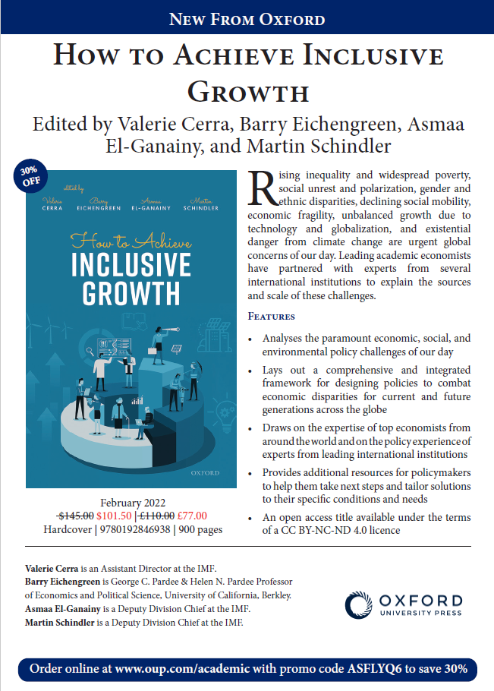
Flyer for Discount on Hardcopy of Book

Slide 50
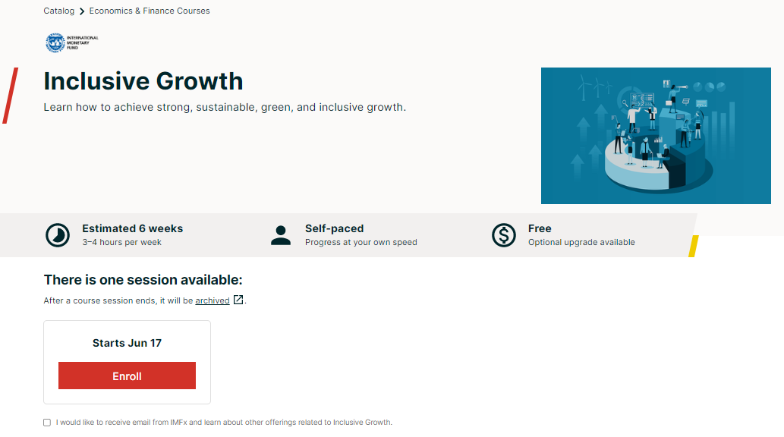
Online Course on Inclusive Growth (IGx)
      Modules:
      An inclusive growth framework
      Measurement of inclusive growth
      Fiscal policy and inclusive growth
      Labor markets, gender, and technology
      Governance
      Climate change
https://www.edx.org/course/inclusive-growth
https://www.edx.org/course/inclusive-growth-concepts-and-indicators
https://www.edx.org/course/inclusive-growth-fiscal-policy
https://www.edx.org/course/inclusive-growth-labor-markets-gender-and-technology
https://www.edx.org/course/inclusive-growth-governance
https://www.edx.org/course/inclusive-growth-climate-change

Slide 51
Thank you!

